Slide 1
CLINICAL AND SOCIODEMOGRAPHIC
CHARACTERISTICS ASSOCIATED WITH
POOR SELF-RATED HEALTH ACROSS MULTIPLE DOMAINS AMONG OLDER ADULTS LIVING WITH HIV
Duncan Short,¹ Frank Spinelli,² Chinyere Okoli,¹ Patricia de los Rios³
¹ViiV Healthcare, Brentford, Middlesex, UK; ²ViiV Healthcare, Research Triangle Park, NC, USA; ³ViiV Healthcare Canada,
Laval, QC, Canada

Slide 2
Beyond Viral Suppression: Going Full 360
UNAIDS Targets
  Diagnosis: 90% of those with HIV will know their status¹
  Treatment: 90% of those diagnosed will be on treatment¹
  Viral suppression: 90% of those on treatment will be virally suppressed¹
  Quality of life: 90% of PLHIV will enjoy good health-related quality of life²
Overall Health
  Health is a state of complete physical, mental, and social well-being and not merely the absence of disease
  or infirmity – World Health Organization³
1. UNAIDS. https://www.unaids.org/en/resources/documents/2017/90-90-90. Accessed June 12, 2020. 2. Lazarus et al. BMC Med. 2016;14:94. 3. World Health Organization. https://www.who.int/about/who-we-are/constitution.
Accessed June 12, 2020.
Short et al. AIDS 2020; Virtual. Slides OAD0903.

Slide 3







Overall Health and Subdomains
Health is a state of complete physical, mental, and social well-being and not merely the absence of disease or infirmity¹
MENTAL HEALTH
Physical health
MENTAL HEALTH
SEXUAL HEALTH
OVERALL HEALTH
Physical health
“Your state of well-being in which you realize your own potential, can cope with the normal stresses of life, can function productively and fruitfully, and are able to contribute to your community”
“Physical condition of your body, specifically the absence of any illness or injury and being free from aches or pains in any part of your body”
OVERALL HEALTH
SEXUAL HEALTH
The totality of all health domains, including physical, mental, and sexual, as well their interactions with each other to influence health
“Your sexual well-being, the quality of your sexual relations, your sex drive (libido), as well as your reproductive health and absence of any (non-HIV) sexually transmitted infections”
1. World Health Organization. https://www.who.int/about/who-we-are/constitution. Accessed June 12, 2020.
Short et al. AIDS 2020; Virtual. Slides OAD0903.

Slide 4
Key Objectives
What proportion of PLHIV aged ≥50 years report suboptimal health
on each individual domain?
What proportion of PLHIV aged ≥50 years report suboptimal health
on all assessed domains?
What are the clinical and demographic characteristics of those reporting suboptimal health on all domains?
Short et al. AIDS 2020; Virtual. Slides OAD0903.

Slide 5
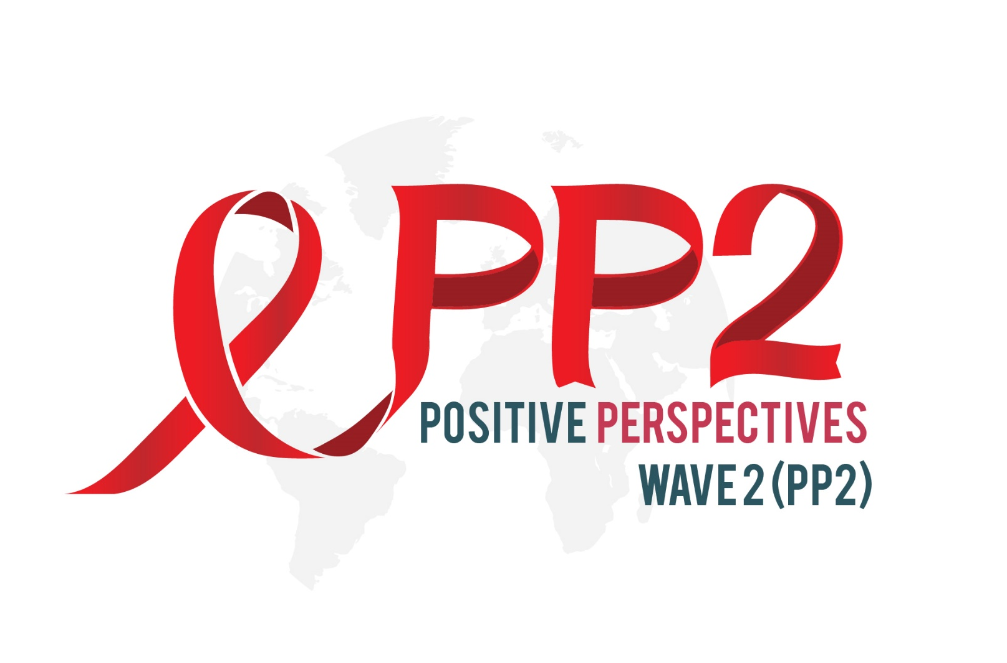
Overview of Positive Perspectives Study Design
Positive Perspectives is a multinational, cross-sectional, web-based survey for PLHIV collected between April and August 2019
Purpose: To understand the health of older PLHIV reporting suboptimal health on multiple domains
Patient population in analysis:
  699 participants aged ≥50 years (of 2389 total adults aged ≥18 years with confirmed HIV status and receiving antiretroviral treatment)
  From 25 countries that together account for 33.1% (12.53 million) of the global HIV burden
Self-rated health assessment:
  Across 4 health domains (physical, mental, sexual, and overall)
  Scored as optimal (“Very good” or “Good”) or suboptimal (“Neither good nor poor,” “Poor,” or “Very poor”)
  Measured for associations between health domains and clinical/demographic characteristics using multinomial logistic regression, adjusting for gender and disease duration
Short et al. AIDS 2020; Virtual. Slides OAD0903.

Slide 6
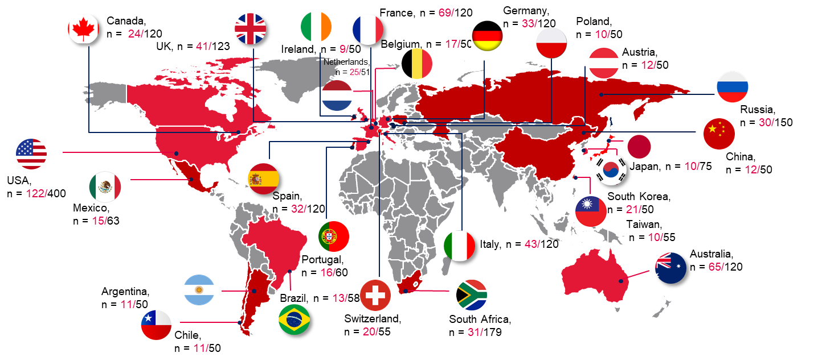
PLHIV Aged ≥50 y in Selected Countries Relative to Total Sample
Mean age among people aged ≥50 years, by region: North America, 59 y; Europe, 56 y;
Latin America, 56 y; Asia, 55 y; Australia, 59 y; South Africa, 54 y
Percentages of females aged ≥50 years by region: North America, 25%; Europe, 33%;
Latin America, 26%; Asia, 32%; Australia, 14%; South Africa, 65%

Slide 7
Self-Reported Suboptimal Health Prevalence
Sexual health was the domain where the highest percentage reported suboptimal status,
among 3 in 5 older adults overall
Short et al. AIDS 2020; Virtual. Slides OAD0903.

Slide 8
Correlation Between the Different Domains of Self-Rated Health
Overall health
The subdomains with the strongest correlation with overall health were
Physical health (Spearman’s correlation, ρ = 0.75)
Mental health (ρ = 0.68)
Sexual health
Mental health
Physical health
Short et al. AIDS 2020; Virtual. Slides OAD0903.

Slide 9
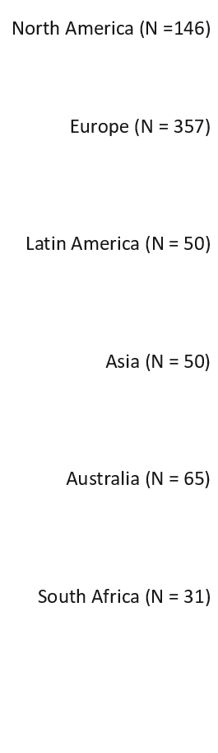
Self-Reported Suboptimal Health Prevalence by Domain and Region
South Africa had the lowest percentage of reported suboptimal health in all domains. This gap narrowed after adjusting for age and sex, but some remained, suggesting the effect of other factors
Short et al. AIDS 2020; Virtual. Slides OAD0903.

Slide 10
Number of Domains on Which Suboptimal Health Was Reported, Overall and by Region
Overall, 26% reported optimal health on all domains, while 23% reported suboptimal health on all domains. Half the population was centered around these 2 extremes
Short et al. AIDS 2020; Virtual. Slides OAD0903.

Slide 11
Comparisons of Individuals Reporting Suboptimal Health on All 4 Domains vs Those Not Reporting Suboptimal Health on Any Domain
Groups most likely to report suboptimal health in all 4 domains included those with 2+ comorbidities,
with suboptimal adherence, or those dissatisfied with treatment
Short et al. AIDS 2020; Virtual. Slides OAD0903.

Slide 12




Conclusions
Of older adults living with HIV, 23% reported suboptimal health and 26% reported optimal health on all domains. Approximately half the population reported results within these 2 extremes.
Geographic disparities exist in self-reported health status. These differences highlight the need for tailoring treatment to narrow inequalities.
Groups with worst perceived health included those reporting ≥2 comorbidities, suboptimal adherence, and those dissatisfied with treatment.
Holistic approach to care requires seeking improvements in all aspects of health and considering patients as a whole. Quality communication is needed to alleviate mental distress, which may not be readily discernable to HCPs.
Short et al. AIDS 2020; Virtual. Slides OAD0903.

