Slide 1
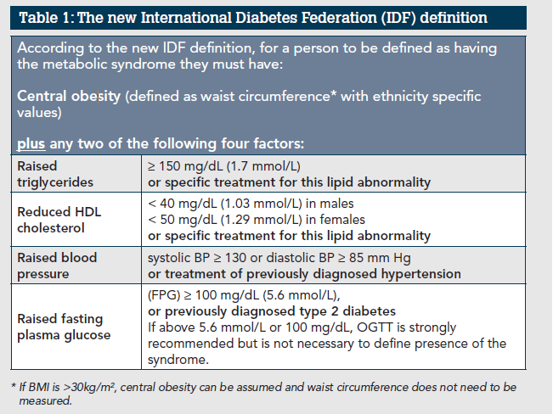
Final Week 192 results from the ADVANCE trial: First-line TAF/FTC+DTG, TDF/FTC+DTG vs TDF/FTC/EFV
W.D.F Venter¹, B. Bosch¹, S. Sokhela¹, G. Akpomiemie¹, N. Chandiwana¹, A. Tembo¹, A.Qavi², B. Simmons³, K. McCann⁴, A. Hill⁵
¹Ezintsha, University of Witwatersrand, Johannesburg, South Africa, ²Imperial College London, London, United Kingdom, ³London School of Economics and Political Science, London, United Kingdom, ⁴University of Connecticut, Connecticut, United States, ⁵Univeristy of Liverpool, Liverpool, United Kingdom
Background
Current World Health Organization guidelines recommend tenofovir disoproxil fumarate (TDF)/lamivudine (or emtricitabine (FTC)) and dolutegravir/ (DTG) for HIV-1 infection. Tenofovir alafenamide (TAF) is listed as an alternative to TDF for patients with osteoporosis or impaired renal function.
The study demonstrated non-inferiority at 48, 96 and 144 weeks, in terms of virologic suppression, with excellent safety in all arms. The one unexpected result, was that weight gain in both DTG-containing arms over EFV was most severe in the TAF/FTC+DTG arm. Following a trial extension to week 192, participants were reconsented so longer term follow up of the weight gain could be assessed, alongside the efficacy and safety profile of all treatments.
Methods
1053 treatment-naïve participants in South Africa were randomised to either TAF/FTC+DTG, TDF/FTC+DTG or TDF/FTC/EFV and followed up to week 192 under a trial extension. HIV-1 RNA, vital signed and renal and bone adverse events were assessed prospectively.
Analyses were conducted using STATA version 14.2 (StataCorp, TX, USA).
The study was overseen by the National Instituted of Health (NIH) multinational HIV DSMB. The study is registered at ClinicalTrials.gov. (NCT03122262)
Results
BMI was balanced across arms at baseline. At week 192 weeks, HIV-1 RNA <50 copies/mL was confirmed in 218/351 (62.3%) in the TAF/FTC+DTG arm, 204/351 (58.1%) in the TDF/FTC+DTG arm, and 177/351 (50.4%) in the TDF/FTC/EFV arm. In the on treatment analysis, HIV-1 RNA <50 copies/mL was 218/226 (96%) for TAF/FTC+DTG, 204/209 (98%) for TDF/FTC+DTG and 177/179 (99%) for TDF/FTC/EFV.
By Week 192, body weight increased by +8.9kg for TAF/FTC+DTG, +5.8kg for TDF/FTC+DTG, and +3.3kg for TDF/FTC/EFV participants (observed data analysis). By Week 192, 29% of patients on TAF/FTC+DTG, 21% on TDF/FTC+DTG and 15% on TDF/FTC/EFV had developed clinical obesity. The risk of clinical obesity was significantly higher if taking TAF/FTC+DTG (p<0.001), female patients (p<0.001) and those with higher baseline BMI (p<0.001). Among the women enrolled, 43% on TAF/FTC+DTG developed clinical obesity by Week 192 versus 27% on TDF/FTC+DTG and 20% taking TDF/FTC/EFV (p<0.001).
Bone fracture and Grade 3 or 4 renal adverse events were rare and similar across arms.
Conclusions
In the ADVANCE trial, participants taking TAF/FTC+DTG experienced greater weight gain and clinical obesity than TDF/FTC/DTG by Week 192, particularly in women, but no significant differences in HIV RNA suppression or renal or bone-related adverse events. Both TAF/FTC+DTG and TDF/FTC+DTG had significantly higher rates of HIV RNA suppression than TDF/FTC/EFV at Week 192 in the main ITT analysis.
ADVANCE: Predictors of obesity (BMI≥30)
Cox Model | Haz. Ratio | 95% Conf. Interval | P>|z|
Treatment group
TDF/FTG+EFV | (Ref)
TDF/FTC/DTG | 1.48 | 0.91-2.41 | 0.112
TAF/FTC/DTG | 3.28 | 2.10-5.14 | <0.001
Age | 0.98 | 0.96-1.00 | 0.057
Baseline BMI | 1.82 | 1.68-1.98 | <0.001
Female | 2.14 | 1.38-3.32 | 0.001
Baseline log₁₀HIV VL | 1.97 | 1.58-2.46 | <0.001
ADVANCE trial: treatment-emergent metabolic syndrome at any visit
_________________________________________________________________________________
Treatment arm TAF/FTC/DTG TDF/FTC/DTG TDF/FTC/EFV
_________________________________________________________________________________
All patients 50/335 (15%) 32/330 (10%) 23/337 (7%)
Women 40/199 (20%) 23/189 (12%) 29/191 (10%)
Men 10/136 (7%) 9/141 (6%) 4/145 (3%)
_________________________________________________________________________________
Risk is significantly higher for TAF/FTC/DTG (p<0.05) for all patients, and for women
ADVANCE: Weight change from baseline over time
ADVANCE: Time to obesity (BMI≥30)

