Slide 1

Flt3 Agonist Enhances
Immunogenicity of Arenavirus-Based Vaccine Vector in Macaques
Archana Vidya Boopathy,¹ Anurag Nekkalapudi,¹ Bhawna Sharma,¹ Sophie Schulha,²
Raphaela Wimmer,² Debi Jin,¹ Janette Sung,¹ Jeffrey Murry,¹ Mark Nagel,¹ Brian Carr,¹
Sarah Ahmadi-Erber,² Henning Lauterbach,² Klaus Orlinger,² Tariro Makadzange,¹
Michelle Kuhne,¹ Romas Geleziunas,¹ Brie Falkard,¹ Sarah Schmidt²
¹Gilead Sciences Inc., Foster City, CA, USA; ²HOOKIPA Pharma, NY, USA
29 July–2 August
Montréal, Québec, Canada

Slide 2
Disclosures
Employment at and stock options in Gilead Sciences

Slide 3
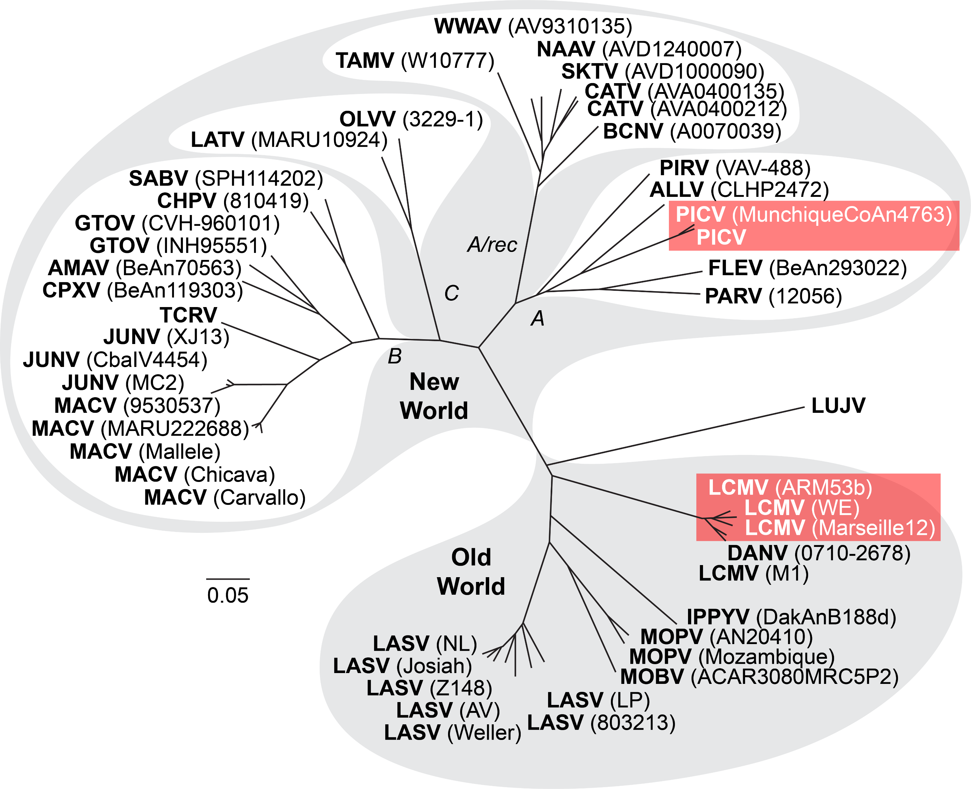
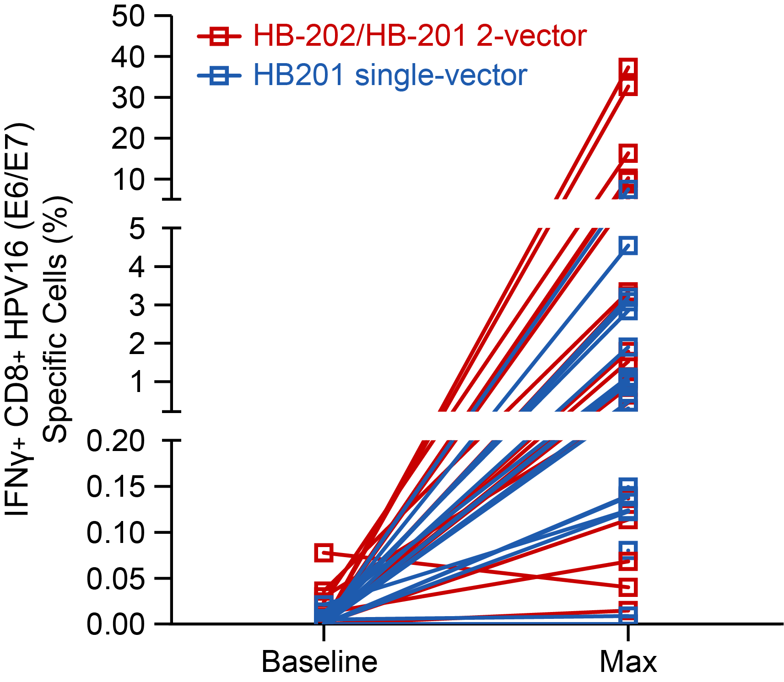
Arenavirus-Based Vector Constructs Generate Robust Antigen-Specific T Cell Responses
Adapted from Briese T, et al.
PLoS Pathog 2009;5:e1000455.
Edwards D, et al. Proc Am Assoc Cancer Res Ann Meeting 2022, abstr 3284.
Arenavirus Phylogenetic Tree
Replicating Arenavirus Vector Platform (trisegmented)
artLCMV and artPICV
Replicating Vector (artPICV/artLCMV)
Phase 1/2 (HPV16)
S-segment 1
% HPV16-Specific CD8+ T Cells
SIV Gag/Env
5’
NP
3’
S-segment 2
SIV Gag/Env
5’
GP
3’
L-segment
Z
Baseline
Max
5’
L
3’
Alternating 2-vector and single-vector immunization with replicating arenavirus vectors elicited strong HPV16 E6/E7 CD8 T-cell response in HPV16+ cancer patients
artLCMV, recombinant lymphocytic choriomeningitis virus with artificial genome arrangement; artPICV, recombinant Pichinde virus with artificial genome arrangement; Env, envelope; Gag, group antigen; GP, glycoprotein; HPV, human papillomavirus; IFN, interferon;
L, polymerase (Pol); NP, nucleoprotein; SIV, simian immunodeficiency virus; Z, matrix protein.

Slide 4
Alternating Vaccination with Arenavirus Vector is Immunogenic and Reduced Set-Point VL After SIV Challenge
SIVmac251
challenge
Week
0
12
20
28
32
72
Placebo (n=8)
Follow up post challenge
artPICV/artLCMV vaccine (n=24)
Peak SIV-Specific IFNγ Response†
Set-Point Viral Load†
Vaccination induces SIV-specific T cell responses
Vaccination with alternating arenavirus vectors (artPICV/artLCMV) resulted in significant decreases in set-point viral load vs placebo
**p<0.01, ***p<0.001, ****p<0.0001, (L) Friedman’s test with Dunn’s post . Dotted line indicates positive threshold set at ≥200 IFNγ SFU/10⁶ peripheral blood mononuclear cells (PBMCs). (R) Mann-Whitney test.
† Boopathy AV, et al., CROI 2022, poster 237. Data are median ± interquartile range (IQR)

Slide 5
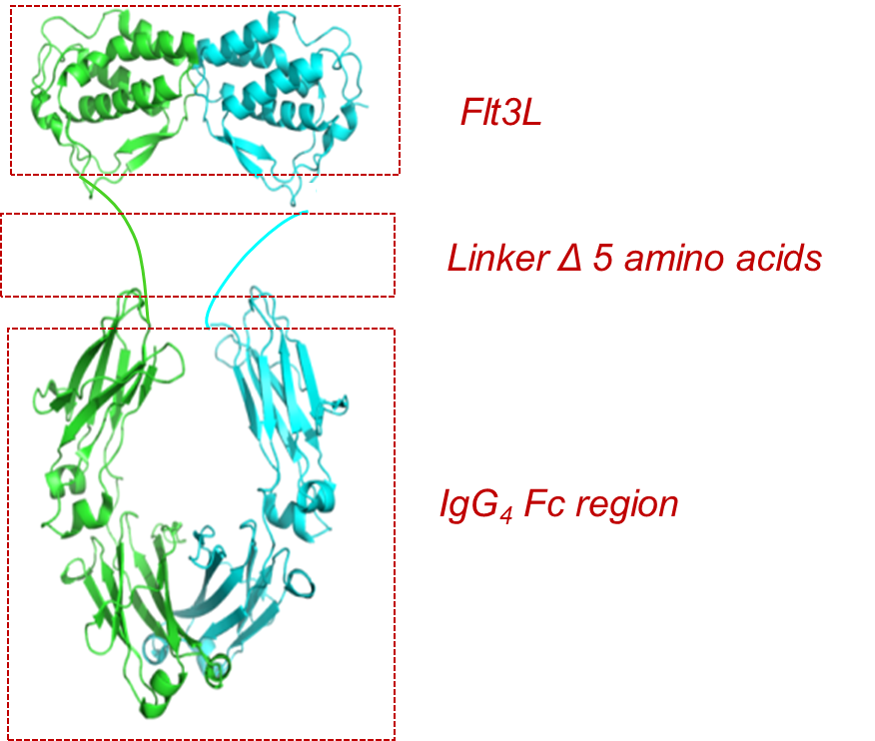
Flt3 Receptor Agonist Increases Peripheral DCs in NHPs
Flt3 Receptor agonist
  Flt3 – Fms like tyrosine kinase 3
  Flt3 ligand extracellular domain—Ig fusion protein
  Promotes differentiation of dendritic cell progenitors coming from the bone marrow to accumulate in the periphery
  Increases cDC1s in peripheral blood in NHPs
  Ongoing clinical trials and development for oncology indications (GS-3583)
Arenavirus based vectors show DC tropism in vitro¹
Can Flt3 receptor agonist-mediated increase in cDC1 promote arenavirus-based vector immunogenicity?
cDC1: CD3−CD20−CD56−HLADR+CD123−CD11chiClec9A+CD1c−. DC, dendritic cell, ¹Flatz L, et al. Nat Med 2010 Mar;16:339-45.

Slide 6
Evaluating Combination of Arenavirus Vectors and Flt3 Receptor Agonist in NHPs
NHP Study Design
Week
0
4
8
12
16
artPICV
Vaccine: route IM
Encodes SIVsmE543 Gag, Env, Pol
Vaccine (n=13)
artLCMV
Vaccine +
Flt3 Receptor agonist (n=13)
Flt3 receptor agonist dosed 7 days before each vaccine dose, route IV
Objective: To evaluate immunogenicity of alternating arenavirus vectors (artPICV/artLCMV) encoding SIV immunogens (Gag, Env, Pol) prime-boost in combination with Flt3 receptor agonist
ELISAs
ELISpot
Flow Cytometry
Notes:
Dose of Flt3R agonist; 0.3mg/kg, GS-1071770

Slide 7
Flt3 Receptor Agonist Increases DCs and Monocytes
Vaccine
Vaccine + Flt3Ra
Dendritic Cells
Monocytes
Combination of alternating arenavirus vectors with Flt3 receptor agonist increases frequency of DCs and monocytes as measured by flow cytometry
DCs gated as CD20−HLADR+CD16−CD14−CD11c+; Classical monocytes gated as CD3−CD20−CD8−HLADR+CD16−CD14+.
Data are median ± IQR; *p<0.05, **p<0.01, ***p<0.001, ****p<0.0001, 2-way analysis of variance (ANOVA) and Dunnett’s post test.

Slide 8
Flt3 Receptor Agonist Increases Vaccine Immunogenicity
Vaccine
Vaccine + Flt3Ra
Magnitude of Peak Response
Breadth of Response After Dose 4
7x
8x ↑
9x ↑
Combination of alternating arenavirus vectors with Flt3 receptor agonist leads to a significant increase in magnitude and breadth of SIV-specific T cell responses as measured by ELISpot
Data are median ± IQR; n=13 per group; **p<0.01, ***p<0.001, ****p<0.0001, Mann-Whitney t-test. Responses measured at 2 weeks post each dose listed.

Slide 9
Flt3 Receptor Agonist Enhances Polyfunctionality of Vaccine-Induced SIV-Specific T Cell Responses
Vaccine
Vaccine + Flt3Ra
CD4
CD8
CD4 T Cells
CD8 T Cells
Responses in
Vaccine + Flt3Ra Group
70x
4x
5x ↑
4x
2x
13x ↑
Combination of alternating arenavirus vectors with Flt3 receptor agonist
  Induces significantly higher SIV-specific polyfunctional CD4 and CD8 T cells expressing IFNγ, TNFα and IL-2 post boost
  Induces balanced polyfunctional CD4 and CD8 T cell response
Data are median ± IQR; n=13 per group; *p<0.05, ns, not significant, Mann-Whitney t-test. IL, interleukin; TNF, tumor necrosis factor.

Slide 10
Flt3 Receptor Agonist Increases Vaccine-induced Env-Binding Antibody Titers
Vaccine
Vaccine + Flt3Ra
LLOQ
Combination of vaccine with Flt3 receptor agonist results in a 3-fold increase in env-binding antibody titers compared with vaccine alone by ELISA
Data are median ± IQR; n=13 per group; *p<0.05, **p<0.01, ****p<0.0001
2-way ANOVA with repeated measures and Sidak’s post test in left graph, Mann-Whitney t-test in right graph. Dotted line indicates lower limit of quantitation (LLOQ) of assay.

Slide 11
Summary
Alternating immunization with arenavirus vectors induces SIV-specific T cell responses and leads to significant reductions in set-point VL after SIVmac251 challenge in NHPs
Flt3 receptor agonist increases peripheral cDC1 in NHPs; no safety concerns observed with repeated dosing
Compared with administration of vaccine alone, combination of arenavirus-based vaccine vectors encoding SIV immunogens with Flt3 receptor agonist results in
  increase of monocytes and dendritic cells
  increase in magnitude and breadth of vaccine-induced SIV-specific T cell response
  induction of SIV-specific IFNγ⁺TNFα ⁺ IL-2⁺ polyfunctional CD4 and CD8 T cells
Taken together, Flt3 receptor agonist augments arenavirus vector-based SIV vaccine immunogenicity in nonhuman primates

Slide 12
Acknowledgments
Research collaboration with Hookipa Pharma
Nonhuman primate studies performed at Bioqual and Vivopharm LLC
Editorial and production assistance were provided by BioScience Communications
This study was funded by Gilead

