Slide 1
START Design
HIV-infected individuals who are ART-naïve with CD4+ count > 500 cells/mm³ (N=4,685)
Immediate ART Group
Initiate ART immediately
following randomization
N=2,326
Deferred ART Group
Defer ART until the CD4+ count declines to < 350 cells/mm³ or
AIDS develops
N=2,359
Primary composite endpoint, target = 213
Serious AIDS or death from AIDS
Serious Non-AIDS Events and death not attributable to AIDS
  CVD, ESRD, decompensated liver disease, & non-AIDS defining cancers
Lundgren IAS 2015, NEJM

Slide 2
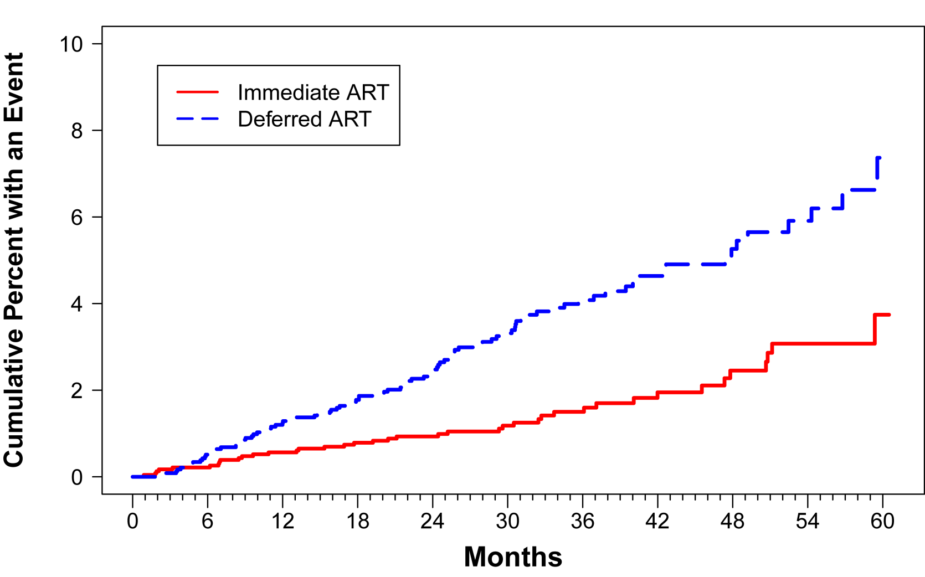
START Primary Endpoint - 1
 | Immediate ART | Deferred ART
No. with Event (%) | 42 (1.8%) | 96 (4.1%)
Rate/100PY | 0.60 | 1.38
HR (Imm/Def) | 0.43 (95% CI: 0.30 to 0.62, p <0.001)
Serious AIDS: 0.28 (95% CI: 0.15 to 0.50, p <0.001)
Serious Non-AIDS: 0.61 (95% CI: 0.38 to 0.97, p=0.04)
5.3
2.5
Lundgren IAS 2015, NEJM

Slide 3
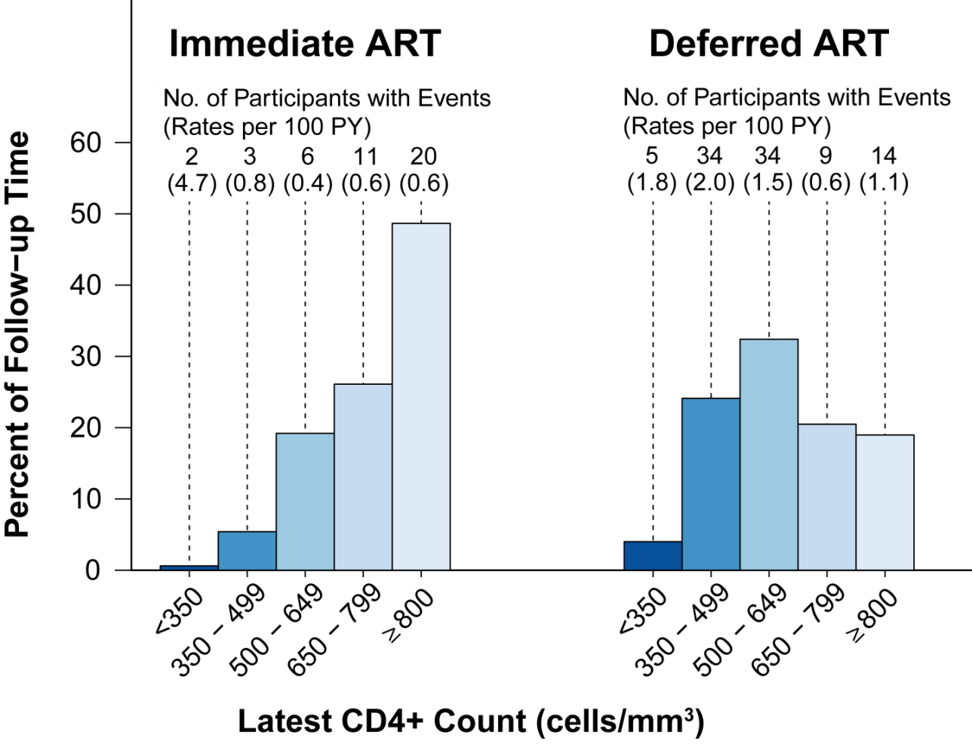
Primary Endpoint Counts and Rates in Participants with Latest CD4+ Count >500 or <350 cells/mm³
Latest CD4+ count >500 cells/mm³:
 | Imm. ART | Defer. ART
% of primary events | 88% (37/42) | 59% (57/96)
Rate (/100 PY) | 0.6 | 1.1
Lundgren IAS 2015, NEJM

Slide 4
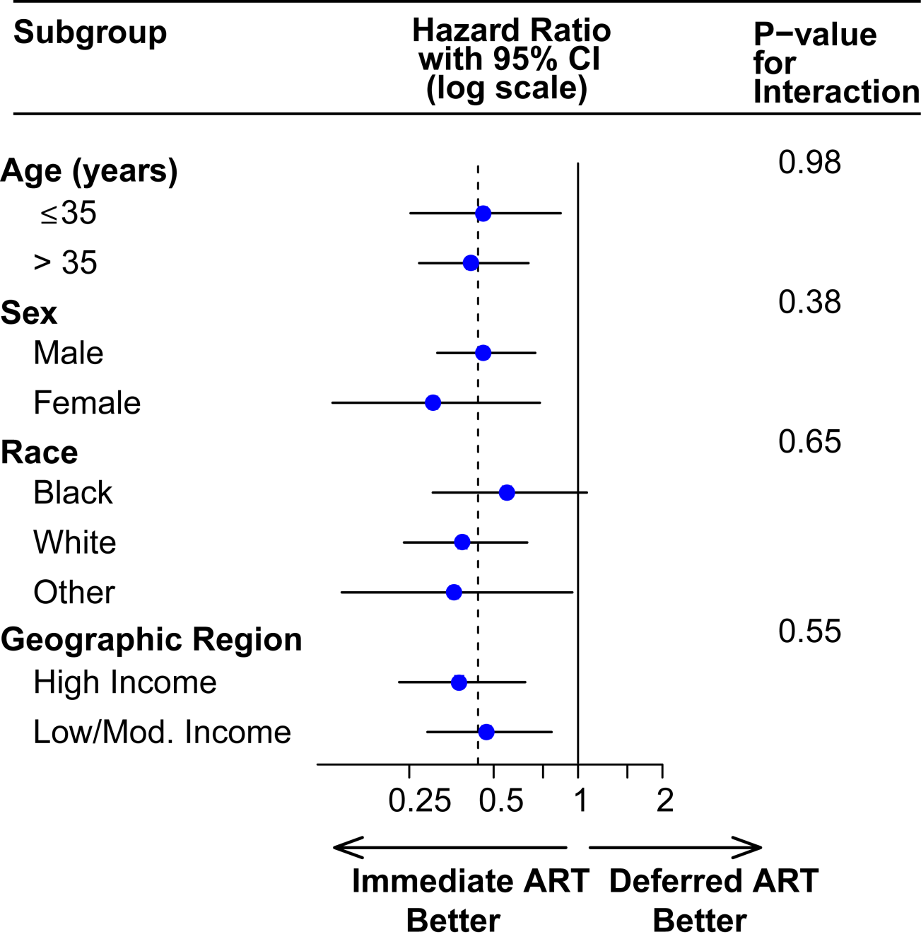
Primary End Point for Subgroups –1
Lundgren IAS 2015, NEJM

