Slide 1
Week 96 safety and efficacy of the novel
HIV-1 attachment inhibitor prodrug fostemsavir in heavily treatment-experienced participants infected with multi-drug–resistant HIV-1 (BRIGHTE Study)
M. Lataillade,¹ J. Lalezari,² J. Aberg,³ J.-M. Molina,⁴ M. Kozal,⁵ P. Cahn,⁶ M. Thompson,⁷
R. Diaz,⁸ A. Castagna,⁹ M. Gummel,¹⁰ M. Gartland,¹¹ A. Pierce,¹¹ P. Ackerman¹ and C. Llamoso¹
¹ViiV Healthcare, Branford, CT, USA. ²Quest Research, San Francisco, CA, USA. ³Icahn School of Medicine at Mount Sinai, New York, NY, USA. ⁴Hospital Saint-Louis, Assistance Publique Hôpitaux de Paris, Paris, France. ⁵Yale University School of Medicine, New Haven, CT, USA. ⁶Fundación Huésped, Buenos Aires, Argentina. ⁷AIDS Research Consortium of Atlanta, Atlanta, GA, USA. ⁸Instituto Nacional de Infectologia Evandro Chagas, Fundação Oswaldo Cruz, Rio de Janeiro, Brazil. ⁹Clinic of Infectious Diseases, Vita-Salute San Raffaele University, Milan, Italy. ¹⁰GlaxoSmithKline, Upper Providence, PA, USA. ¹¹ViiV Healthcare, Research Triangle Park, NC, USA.
MOAB0102

Slide 2
Financial disclosures
This study was funded by ViiV Healthcare
Max Lataillade, DO MPH
  VP and Head, Clinical Development
  Employee and shareholder of ViiV Healthcare

Slide 3
Overview of fostemsavir (FTR)
Prodrug metabolized to temsavir (TMR), a first-in-class attachment inhibitor that binds to HIV‑1 gp120, preventing initial viral attachment and entry into the host CD4+ T cell^{1,2}
Unique resistance profile with no in vitro cross-resistance to other antiretroviral (ARV) classes^{3,4} and activity regardless of HIV-1 tropism^{3–6}
BRIGHTE (NCT02362503) is an ongoing Phase 3 study evaluating FTR in heavily treatment‑experienced (HTE) adults with multi-drug–resistant HIV-1^{7,8}
  Primary endpoint achieved: superior efficacy vs placebo after 8 days of functional monotherapy
  Day 8 median 1 log₁₀ c/mL HIV-1 RNA decrease in participants with baseline HIV-1 RNA >1000 c/mL^{7–8}
  Clinically significant rates of virologic response were maintained between Week 24 and Week 48⁸
We present here Week 96 efficacy and safety results
1. Brown J, et al. J Pharm Sci. 2013;102(6):1742–1751; 2. Langley DR, et al. Proteins. 2015;83 (2):331–350;
3. Nowicka-Sans B, et al. Antimicrob Agents Chemother. 2012;56(7):3498–3507; 4. Li Z, et al. Antimicrob Agents Chemother. 2013;57(9):4172–4180;
5. Ray N, et al. J Acquir Immune Defic Syndr. 2013;64(1):7–15; 6. Zhou N, et al. J Antimicrob Chemother. 2014;69(3):573–581;
7. Kozal M, et al. 16th European AIDS Conference, October 25–27, 2017. Milan, Italy: Abstract PS8/5;
8. Aberg J, et al. HIV Drug Therapy, October 28–31, 2018. Glasgow, UK: Abstract O334A.

Slide 4
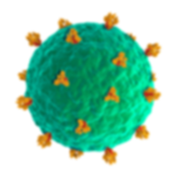
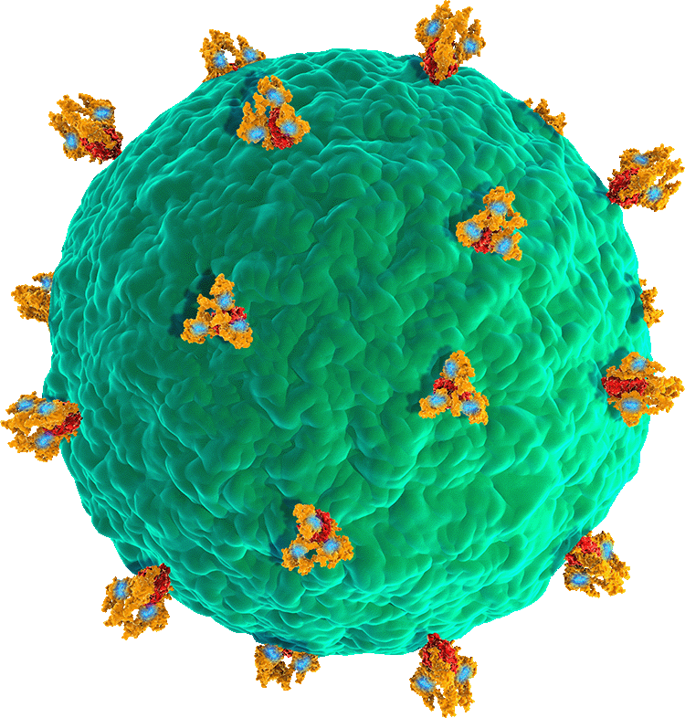

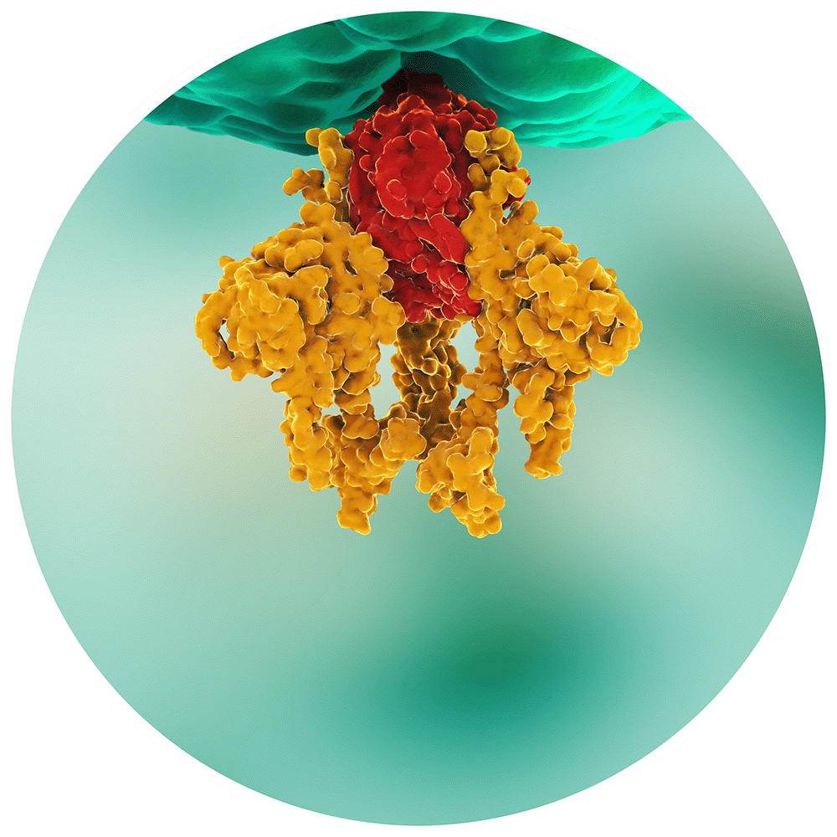
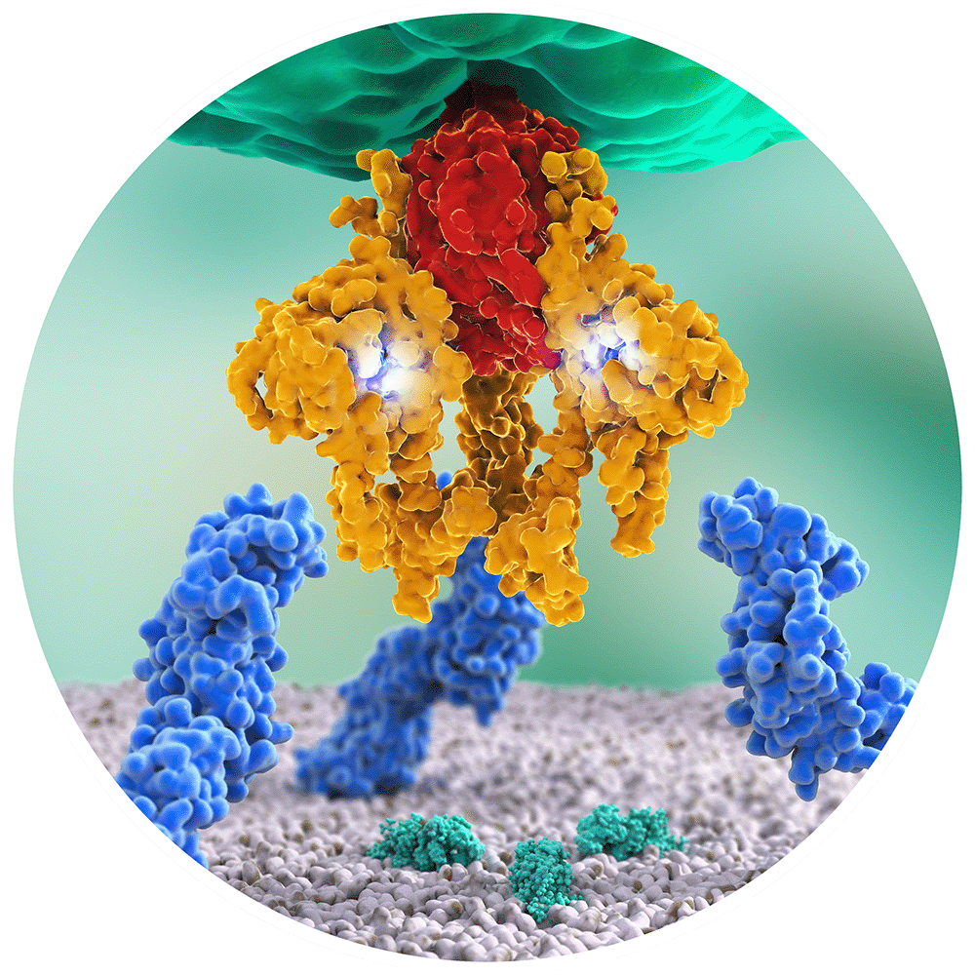
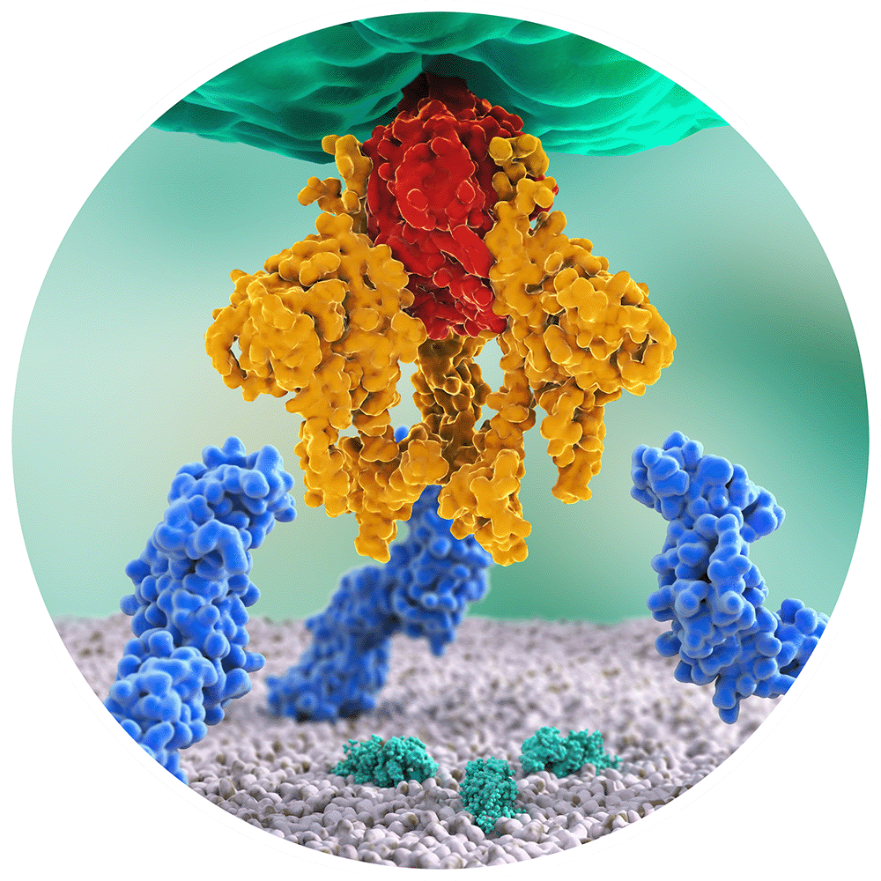
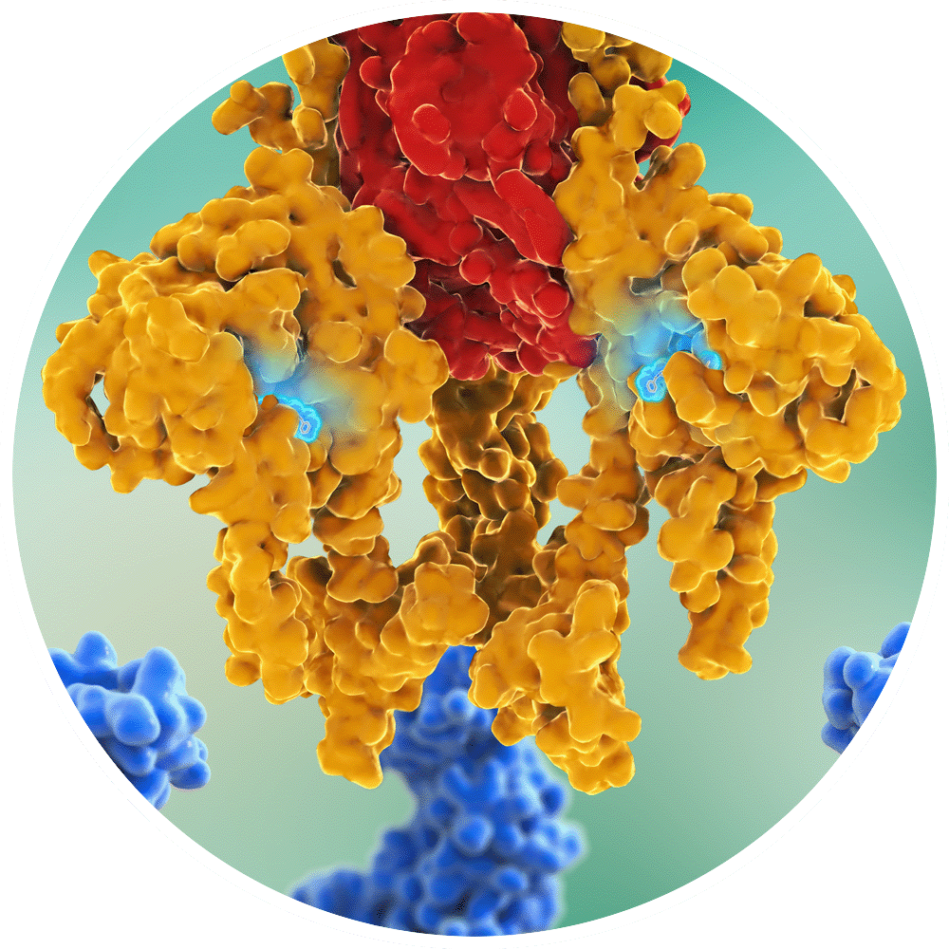
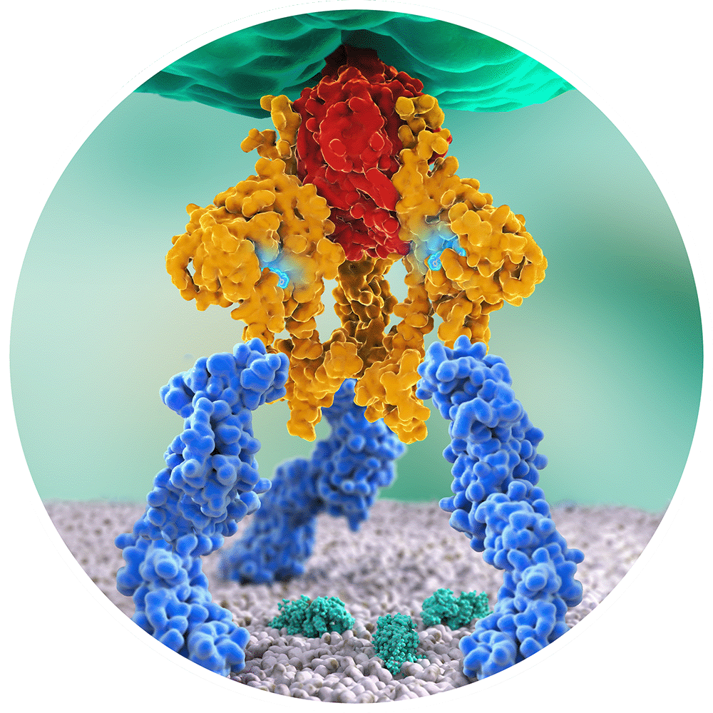
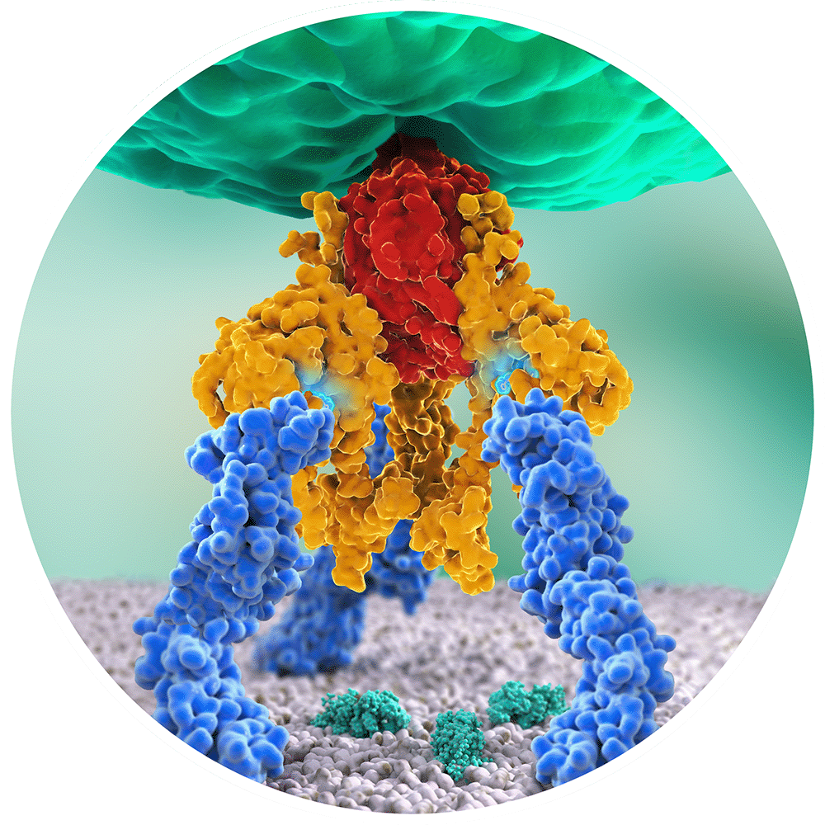
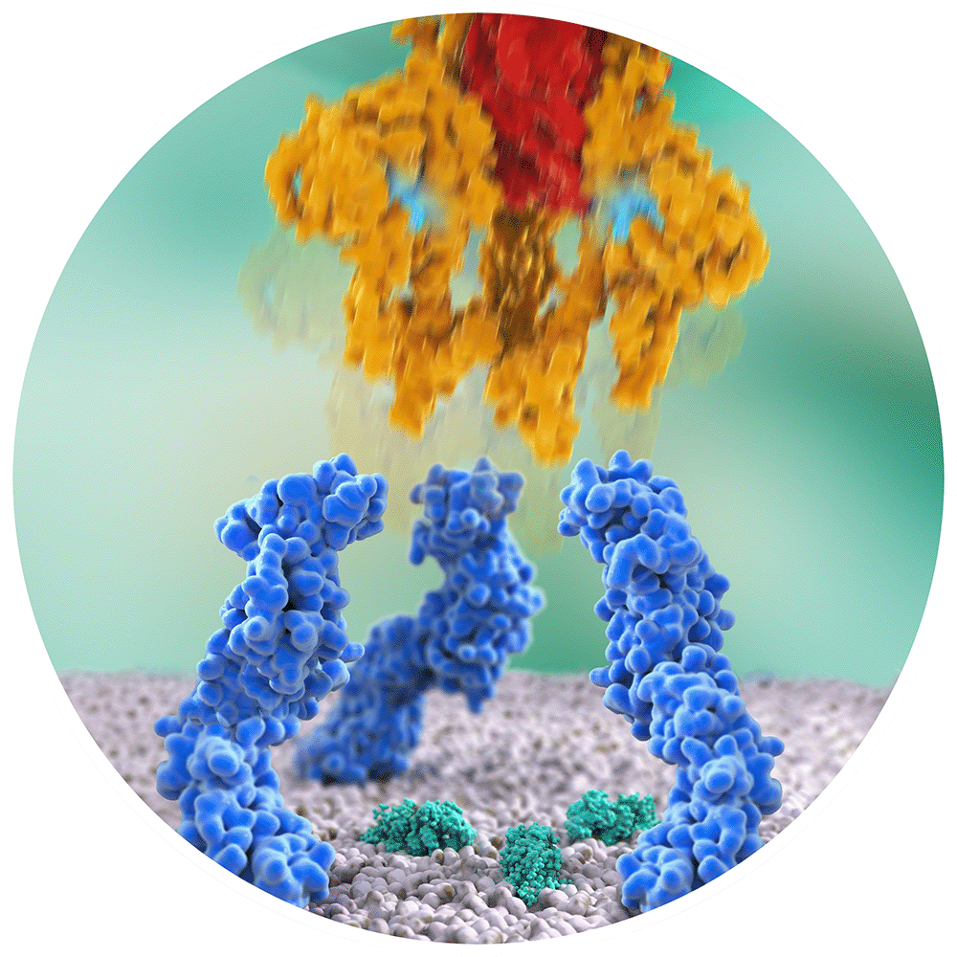
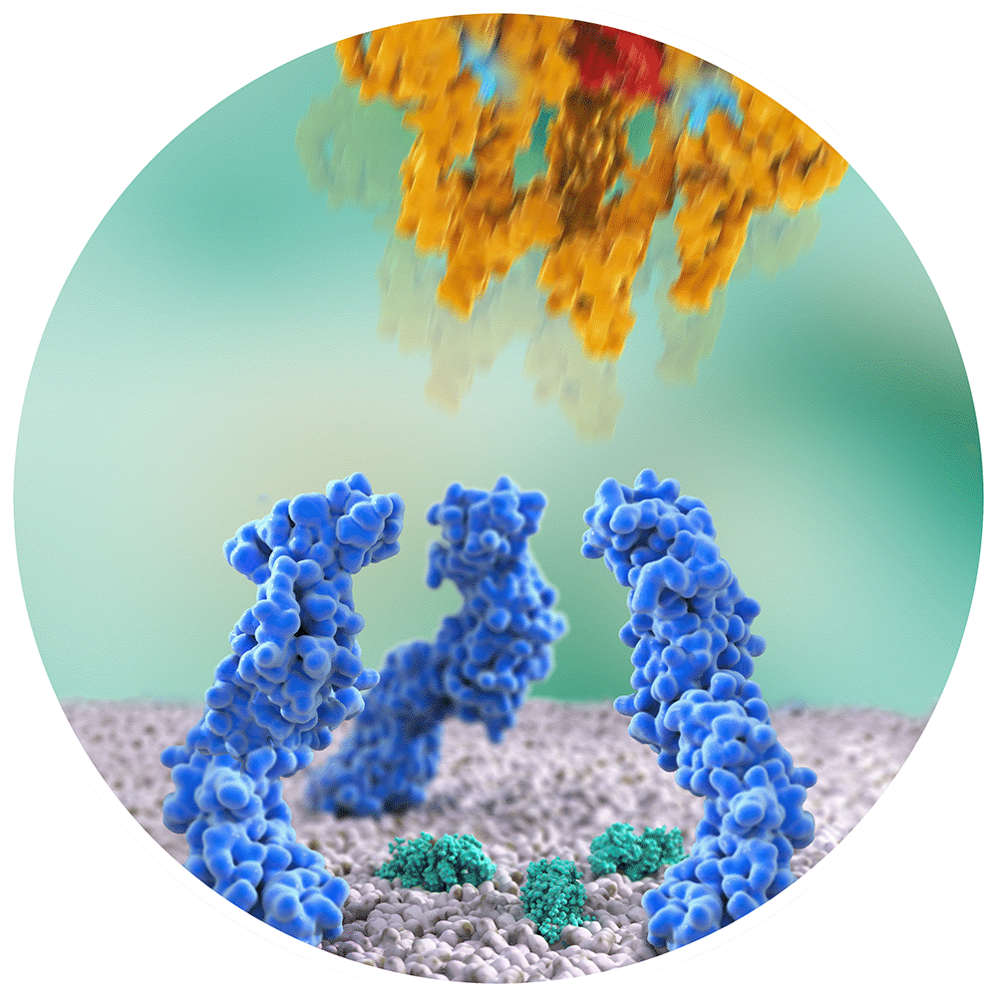
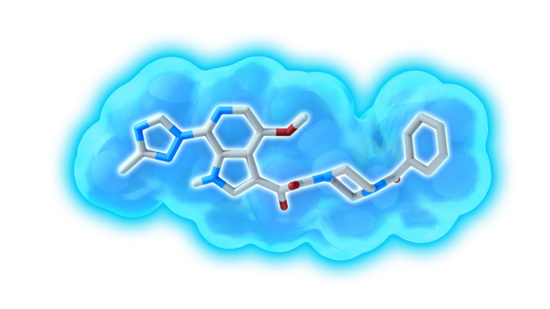
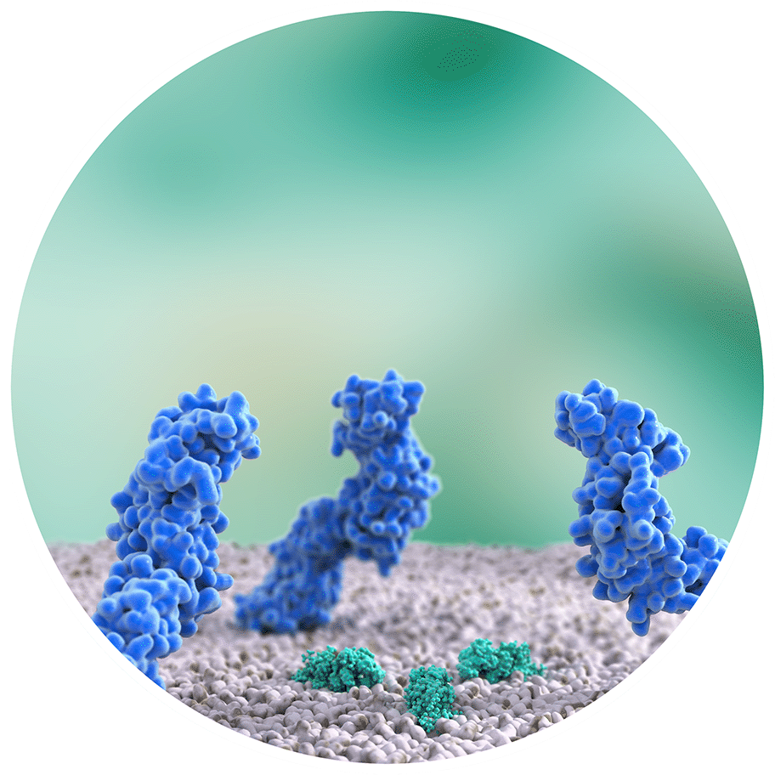
Temsavir proposed mode of action
Temsavir prevents gp120
conformational
change,
inhibiting
HIV-1
attachment
CD4 binding
site
Attachment inhibited
Temsavir
Temsavir binds
near the
CD4 binding site
gp120 trimer
gp41 trimer
gp160
CD4 receptor
CCR5/CXCR4
Conceptualization and design by Max Lataillade (ViiV Healthcare) and John Wong (Synaptik Digital), funded by ViiV Healthcare

Slide 5
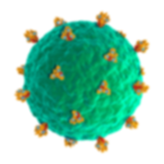
Viruses accumulate in extracellular space…
Viruses accumulate in extracellular space
and are subsequently removed by the host immune system
Conceptualization and design by Max Lataillade (ViiV Healthcare) and John Wong (Synaptik Digital), funded by ViiV Healthcare

Slide 6

Study design
BRIGHTE is an ongoing Phase 3 randomized, placebo-controlled, double-blind trial
Randomized Cohort:*
HTE participants failing current regimen with confirmed HIV-1 RNA ≥400 c/mL and:
1 or 2 ARV classes remaining with ≥1 fully active† approved agent per class
Unable to construct viable regimen from remaining agents
Blinded
FTR 600 mg
BID + failing
regimen
Randomized
3:1
Open-label FTR 600 mg BID + OBT
Blinded
placebo +
failing
regimen
Day 1
Day 8
Primary
Endpoint
Day 9
Open-label
FTR + OBT
Week 24‡
Week 48‡
Week 96‡,**
End of
Study§
Non-randomized Cohort:*
HTE participants failing current regimen with confirmed HIV-1 RNA ≥400 c/mL and:
0 ARV classes remaining and no remaining fully active† approved agents¶
Non-randomized
Open-label FTR 600 mg BID + OBT
Day 1
Week 24
Week 48
Week 96**
End of
Study§
*There were no screening TMR IC₅₀ criteria. †Fully active = no current or historical evidence of resistance & the participant is tolerant of, eligible for, and willing to take (in the case of enfuvirtide) the ARV. ‡Measured from the start of open-label FTR 600 mg BID + OBT. §The study is expected to be conducted until an additional option, rollover study, or marketing approval is in place.
¶Use of investigational agents as part of OBT was permitted. **Week 96 database lock August 14, 2018.
BID, twice daily; OBT, optimized background therapy.
ClinicalTrials.gov Identifier: NCT02362503; EudraCT Number: 2014-002111-41

Slide 7
Study disposition through Week 96
731 screened
360 screening failures*,†
Randomized Cohort
N=272
Non-randomized Cohort
N=99
59 (22%) withdrawn
7 adverse events
12 lack of efficacy
11 non-adherence
5 withdrew consent
8 lost to follow-up
5 met stopping criteria
9 death
1 pregnancy
1 other
38 (38%) withdrawn
4 adverse events
6 lack of efficacy
6 non-adherence
1 withdrew consent
1 lost to follow-up
4 met stopping criteria
15 death
0 pregnancy
1 other
213 (78%) ongoing
61 (62%) ongoing
*Including 12 individuals who met screening criteria but were not randomized or treated (4 withdrew consent, 2 lost to follow-up, 6 other).
†The two most common reasons for screening failure were: i) >2 ARV classes remaining, ii) failing the current ARV regimen with plasma HIV-1 RNA <400 copies/mL.

Slide 8
Baseline characteristics
Parameter | Randomized Cohort |  |  | Non-randomized Cohort | Total treated participants (N=371)
 | Placebo BID (N=69) | FTR 600 mg BID (N=203) | Total randomized (N=272) | FTR 600 mg BID (N=99)
Age, years, median (range) <50 years, n (%) | 45 (19–66) 46 (67) | 48 (18–73) 116 (57) | 48 (18–73) 162 (60) | 50 (17–72) 44 (44) | 49 (17–73) 206 (56)
Gender, n (%) Female | 12 (17) | 60 (30) | 72 (26) | 10 (10) | 82 (22)
Race, n (%) White Black/African American | 48 (70) 18 (26) | 137 (67) 42 (21) | 185 (68) 60 (22) | 74 (75) 23 (23) | 259 (70) 83 (22)
HIV-1 RNA log₁₀ c/mL, median (IQR) | 4.5 (3.6–5.2) | 4.7 (4.0–5.1) | 4.7 (3.9–5.1) | 4.3 (3.6–4.8) | 4.6 (3.9–5.0)
HIV-1 RNA c/mL, n (%) <400 400 to <1000 1000 to <100,000 ≥100,000 | 7 (10) 3 (4) 35 (51) 24 (35) | 14 (7) 7 (3) 126 (62) 56 (28) | 21 (8) 10 (4) 161 (59) 80 (29) | 5 (5) 4 (4) 75 (76) 15 (15) | 26 (7) 14 (4) 236 (64) 95 (26)
CD4+ T cells/µL, median (IQR) | 100 (23–244) | 99 (15–203) | 99 (15–203) | 41 (6–161) | 80 (11–202)
CD4+ T cells/µL, n (%) <20 20 to <50 50 to <200 200 to <500 ≥500 | 17 (25) 6 (9) 26 (38) 16 (23) 4 (6) | 55 (27) 19 (9) 76 (37) 42 (21) 11 (5) | 72 (26) 25 (9) 102 (37) 58 (21) 15 (6) | 40 (40) 14 (14) 25 (25) 18 (18) 2 (2) | 112 (30) 39 (11) 127 (34) 76 (20) 17 (5)
AIDS history,* n (%) | 61 (88) | 170 (84) | 231 (85) | 89 (90) | 320 (86)
*AIDS history recorded if a participant has nadir CD4+ count <200 cells/µL, or prior history of AIDS defining illness.

Slide 9
Baseline prior ARV exposure and resistance
Prior exposure to ARV classes
ARV classes exhausted at baseline*
FAA in initial OBT
Number of FAA
ARV class
ARV class
Randomized Cohort (N=272)
Non-randomized Cohort (N=99)
*Proportions of participants for whom there are no remaining FAAs within the indicated ARV class, based on Monogram assays (PhenoSense® GT Plus Integrase, Trofile®, and PhenoSense® Entry), historical resistance, eligibility, and tolerability. †15/19 received investigational ARV ibalizumab and 4/19 were incorrectly assigned to the Non-randomized Cohort.
FAA, fully active ARV; FI, fusion inhibitor; INI, integrase inhibitor; NRTI, nucleoside reverse transcriptase inhibitor; NNRTI, non-NRTI; PI, protease inhibitor; R5 ant, CCR5 antagonist.

Slide 10
Most common antiretroviral agents in initial OBT
Randomized Cohort (N=272)
Non-randomized Cohort (N=99)
84
Not fully active*
Not fully active*
Fully active*
75
75
Fully active*
72
49
43
20
19
21
10
11
15
8
DTG
(92% BID)
DRV
(89% BID)
TFV
(96% TDF)
Most common ARVs‡
Most common ARVs‡
*Based on Monogram assays (PhenoSense® GT Plus Integrase, Trofile®, and PhenoSense® Entry), historical resistance, eligibility, and tolerability.
†Numbers at the top of the bars show the percent of all participants in the cohort who included the ARV in their OBT.
‡ARVs that were included in the OBT for at least 10% of study participants in either cohort.
DRV, darunavir; DTG, dolutegravir; ENF, enfuvirtide; ETR, etravirine; IBA, ibalizumab; MVC, maraviroc; TDF, tenofovir disoproxil fumarate; TFV, tenofovir.

Slide 11
HIV-1 RNA <40 copies/mL through Week 96
Snapshot analysis, ITT-E*
Randomized Cohort (N=272)
Week 96 outcome, n (%) | Randomized Cohort (N=272)
HIV-1 RNA <40 copies/mL | 163 (60)
HIV-1 RNA ≥40 copies/mL | 81 (30)
Data in window not below threshold | 33 (12)
D/C for lack of efficacy | 10 (4)
D/C for other reason while not below threshold | 17 (6)
Change in ART† | 21 (8)
No virologic data | 28 (10)
D/C study due to AE or death | 15 (6)
D/C study for other reasons | 8 (3)
Missing data during window | 5 (2)
Participants (%)
*Snapshot analysis did not include baseline. One participant had HIV-1 RNA <40 copies/mL at baseline.
†Change in OBT for efficacy reasons were considered virologic failures in this analysis.
AE, adverse event; ART, antiretroviral therapy; D/C, discontinued; ITT-E, intent-to-treat exposed population.

Slide 12
HIV-1 RNA <40 copies/mL through Week 96
Snapshot analysis, ITT-E*
Non-randomized Cohort (N=99)
Week 96 outcome, n (%) | Non-randomized Cohort (N=99)
HIV-1 RNA <40 copies/mL | 37 (37)
HIV-1 RNA ≥40 copies/mL | 43 (43)
Data in window not below threshold | 15 (15)
D/C for lack of efficacy | 3 (3)
D/C for other reason while not below threshold | 6 (6)
Change in ART† | 19 (19)
No virologic data | 19 (19)
D/C study due to AE or death | 14 (4)
D/C study for other reasons | 4 (14)
Missing data during window | 1 (1)
Participants (%)
Among the 15 participants who received ibalizumab in their initial OBT, the response rate (HIV-1 RNA <40 copies/mL)
at Week 96 was 33% (5/15)
*Snapshot analysis did not include baseline. One participant had HIV-1 RNA <40 copies/mL at baseline.
†Change in OBT for efficacy reasons were considered virologic failures in this analysis.

Slide 13
Virologic response through Week 96
Observed analysis
Randomized Cohort (N=272)
Non-randomized Cohort (N=99)
HIV-1 RNA c/mL
HIV-1 RNA c/mL
†
*At baseline 8 participants had HIV-1 RNA <400 copies/mL, 5 had HIV-1 RNA <200 copies/mL, and 1 had HIV-1 RNA <40 copies/mL.
†At baseline 5 participants had HIV-1 RNA <400 copies/mL, 4 had HIV-1 RNA <200 copies/mL, and 1 had HIV-1 RNA <40 copies/mL.

Slide 14
Mean change from baseline in CD4+ T-cell count through Week 96
By Randomized and Non-Randomized Cohort
By baseline CD4+ T-cell category
Randomized Cohort
Baseline CD4+ T cells/mm³
205
(n=213)
240
172
(n=217)
139
(n=228)
90
(n=247)
96
(n=72)
119
(n=65)
64
(n=83)
41
(n=87)
Among randomized participants with CD4+ T-cell count <50 cells/mm³ at baseline (n=71), 56% had ≥200 cells/mm³ at Week 96
  Subgroup data are presented in poster MOPEB234
SD, standard deviation.

Slide 15
Mean CD4+/CD8+ ratio through Week 96
Randomized Cohort (N=272)
CD4+/CD8+ ratio has been identified as a marker of risk for non-AIDS-related morbidity and mortality, independent of CD4+ T-cell count¹
1. Mussini C, et al. Lancet HIV. 2015;2(3):e98-106.

Slide 16
Week 96 safety summary
Parameter, n (%) | Randomized Cohort (N=272)* | Non-randomized Cohort (N=99) | Total treated participants (N=371)
Any event | 249 (92) | 98 (99) | 347 (94)
Any Grade 2–4 AE | 216 (79) | 87 (88) | 303 (82)
Drug-related Grade 2–4 AEs | 57 (21) | 22 (22) | 79 (21)
Any Grade 3/4 AE | 78 (29) | 49 (49) | 127 (34)
Any SAE† | 92 (34) | 48 (48) | 140 (38)
Drug-related SAE‡ | 9 (3) | 3 (3) | 12 (3)
Any AE leading to discontinuation | 14 (5) | 12 (12) | 26 (7)
Any CDC Class C event | 23 (8) | 15 (15) | 38 (10)
Death§ | 12 (4) | 17 (17) | 29 (8)
All safety data reflect cumulative results collected through the data cutoff date of August 14, 2018. *Includes participants randomized to the placebo group who received FTR 600 mg BID during the open-label phase; only data from initiation of open-label FTR dosing are presented. †The only SAEs occurring in at least 2% of participants were pneumonia (n=15), cellulitis (n=8), and acute kidney injury (n=6). ‡Drug-related SAEs (16 events in 12 participants) included: nephrolithiasis (n=2); immune reconstitution inflammatory syndrome (n=3); and one each of acute kidney injury, renal impairment, hyperglycemia, hyperkalemia, loss of consciousness, myocarditis, hepatocellular injury, rhabdomyolysis, fetal growth restriction, disorientation, and rash. §18/29 deaths were due to AIDS‑related events or acute infections (one case was considered treatment-related: immune reconstitution inflammatory syndrome, related to recurrent atypical mycobacterial infection). 5/29 deaths occurred after the participant had discontinued from the study. AE, adverse event; SAE, serious adverse event.

Slide 17
Drug-related Grade 2–4 AEs and
AEs leading to discontinuation
Parameter, n (%) | Randomized Cohort (N=272)* | Non-randomized Cohort (N=99) | Total treated participants (N=371)
Drug-related Grade 2–4 AEs | 57 (21) | 22 (22) | 79 (21)
Occurring in ≥2% of participants in either cohort
Nausea | 9 (3) | 5 (5) | 14 (4)
Diarrhea | 6 (2) | 3 (3) | 9 (2)
Headache | 6 (2) | 1 (1) | 7 (2)
IRIS | 7 (3) | 0 | 7 (2)
Vomiting | 4 (1) | 2 (2) | 6 (2)
Fatigue | 3 (1) | 2 (2) | 5 (1)
Asthenia | 2 (<1) | 2 (2) | 4 (1)
AE leading to discontinuation | 14 (5) | 12 (12) | 26 (7)
In ≥2 participants
Abdominal pain | 2 (<1) | 0 | 2 (<1)
Electrocardiogram QT prolonged | 2 (<1) | 1 (1) | 3 (<1)
Non-cardiac chest pain | 1 (<1) | 1 (1) | 2 (<1)
Hepatic failure | 0 | 2 (2) | 2 (<1)
All safety data reflect cumulative results collected through the data cutoff date of August 14, 2018. *Includes participants randomized to the placebo group who received FTR 600 mg BID during the open-label phase; only data from initiation of open-label FTR dosing are presented.
IRIS, immune reconstitution inflammatory syndrome.

Slide 18
Conclusions
In the BRIGHTE study, evaluating FTR in HTE participants through Week 96:
Virologic response continued to improve over time despite continued attrition in this
difficult-to-treat population
Clinically significant and continuous improvements in CD4+ T-cell count and CD4:CD8 ratio were observed through Week 96, including among those who were most immune‑compromised at baseline
FTR-containing regimens remained generally safe, and well tolerated through
Week 96 with no new safety signals and few AE-related discontinuations
BRIGHTE results support continued development of FTR as an important treatment option for HTE people living with multi-drug–resistant HIV-1
Subgroup data are presented in poster MOPEB234

Slide 19
Acknowledgments
We would like to thank all of the BRIGHTE clinical trial participants and their families
ViiV Healthcare and GSK personnel: Mark Krystal, Andrew Clark, Frank Mannino, Marcia Wang, Louise Garside, and Jill Slater
Monogram Biosciences: Carmeliza Santos
Professional medical writing and editorial assistance was provided by Esther Race at ArticulateScience and 3D graphics were developed by John Wong at Synaptik Digital, both funded by ViiV Healthcare

Slide 20























BRIGHTE investigators
Argentina: P Cahn, L Cassetti, DO David, E Loiza, D Cecchini, S Lupo, M Martins,
C Zala
Australia: A Carr, J McMahon
Belgium: S De Wit, E Florence
Brazil: CR Alves, J Andrade Neto,
M Della Negra, R Diaz, B Grinsztejn,
J Madruga, K Morejon, F Ribeiro, E Sprinz
Canada: M Murray, J Szabo, S Trottier,
S Walmsley
Chile: J Ballesteros,F Zamora, C Beltran, C Chahin Anania, C Perez, M Wolff
Colombia: J Velez
France: PM Girard, C Katlama,
J-M Molina, D Neau, G Pialoux,
I Poizot-Martin, F Raffi, D Salmon-Ceron
Germany: K Arastéh, A Baumgarten,
J Bogner, M Hower, W Kern,
D Schürmann, C Stephan
Greece: S Metallidis, V Paparizos
Ireland: P Mallon
Italy: A Antinori, R Cauda, A Lazzarin,
G Migliorino, C Mussini, G Orofino,
G Rizzardini
Mexico: PF Belaunzaran, R Cabello,
J Duque Rodríguez, M Santoscoy-Gómez, SC Treviño
Netherlands: I Hoepelman
Peru: F Mendo, Y Pinedo Ramirez
Poland: M Parczewski, B Knysz
Portugal: N Janeiro, F Maltez
Romania: L Preotescu, A Streinu-Cercel
South Africa: G Latiff, I Mitha
Spain: JM Llibre Codina,
S Moreno Guillén, J Pineda
Taiwan: SM Hsieh
United Kingdom: A Pozniak
United States: J Aberg, J Bartczak,
M Berhe, T Campbell, C Creticos,
E DeJesus, V Drelichman, C Durand,
J Eron, C Fichtenbaum, R Grossberg,
S Gupta, F Haas, D Hagins, M Jain,
M Kozal, P Kumar, J Lalezari, J Lennox,
R Loftus, R Lubelchek, J McGowan,
M McKellar, A Mills, J Morales-Ramirez,
O Osiyemi, N Ramgopal, S Schrader,
J Slim, P Tebas, M Thompson, W Towner, T Wilkin, A Wurcel

Slide 21
Questions

