Slide 1
Virologic Failure In ART-Naive HIV Patients With High Pre-Therapy Viral Load Burden
Initiating On Common Core Agents
Anthony M. Mills, M.D.

Slide 2
Disclosures
Anthony Mills has received research funding from Gilead Sciences, ViiV Healthcare, Janssen, Merck and Sangamo
He is on advisory boards for Gilead Sciences, ViiV Healthcare, Janssen & Merck

Slide 3
Background
Previous work has suggested that a sizeable proportion of naïve patients present with baseline VL ≥ 100K copies/mL (ISPOR 2019)
Achieving virologic suppression in these patients can be challenging (DiBiagio, 2014; Raffi, 2017)

Slide 4
Objective
We assessed the effectiveness of dolutegravir (DTG), elvitegravir (EVG), raltegravir (RAL) and darunavir (DRV) on rates of virologic failure (VF) in antiretroviral (ART) naïve patients initiating therapy with a high viral load burden (≥ 100,000 copies/mL) in a real world setting

Slide 5
METHODS

Slide 6
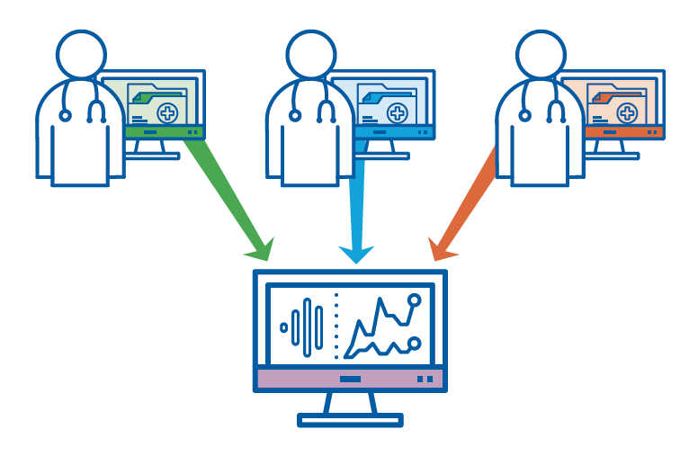
Study Population: Data Source
Observational Pharmaco-Epidemiology Research & Analysis (OPERA) cohort
Prospectively captured, routine clinical data from electronic health records
Notes:
OPERA-participating clinicians documented the care of almost 1,000,000 patients in their EHRs
104K HIV+ patients of which 19% are women, representing 7 percent of all the HIV+ patients diagnosed in the U.S.
OPERA database is refreshed daily, is the largest continuously operating cohort of HIV+ patients in the U.S.
Average years of follow-up for HIV+ patients in OPERA is 4.3 years
13K HIV+ patients have ten years or more of follow-up

Slide 7
U.S. Map of OPERA & CDC, HIV+ Population
100,000+ Patients
65 Cities
19 States
1 US Territory
Notes:
the darker the shading, the higher the CDC reported rates of HIV diagnosis in that state
the larger the red circle, the bigger the OPERA site.

Slide 8
Study Design
Eligibility Criteria
  HIV-positive
  ≥ 13 years of age
  ART naïve, prescribed DTG, EVG, RAL or DRV by an OPERA caregiver
  Baseline viral load ≥100,000 copies/mL
Eligibility period
  August 12, 2013 to July 31, 2017
  Follow-up through July 31, 2018
Baseline
  Date of core agent initiation
Notes:
may want to point out verbally that these 4 core agents were used in combination with 2 NRTIs

Slide 9
Definition of Virologic Failure
VL ≥200
VL ≥200
A
Never Achieved Virologic Suppression
VL ≥200
B
VL ≥200
VL ≥200
C
Achieved & Lost Virologic Suppression
VL ≥200
D
ART initiation
36 weeks
Viral load >50 copies/mL
VL ≥200
Viral load ≥200 copies/mL
Viral load ≤50 copies/mL
Core agent discontinuation
Notes:
Blue line indicates time where VL>50 copies/mL.
Four VF definitions
A: 2 consecutive VLs ≥200 copies/mL after 36 weeks of ART, or
B: 1 VL ≥200 copies/mL with core agent discontinuation after 36 weeks, or
C: 2 consecutive VL ≥200 copies/mL after suppression (VL ≤50 copies/mL) before 36 weeks, or
D: 1 VL ≥20 copies/mL with discontinuation after suppression before 36 weeks.

Slide 10
Analyses
Unadjusted and adjusted cumulative virologic failure probability
  Kaplan Meier methods
  Multivariate Cox Proportional Hazards model
  Adjustment set: baseline age, sex, race, CD4 cell count, HIV RNA VL, history of AIDS, VACS score, drug abuse, history of syphilis infection, calendar year of ART initiation, route of infection and type of health coverage

Slide 11
RESULTS

Slide 12
Study Population (N=2,038)
DRV
n=326, 16%

Slide 13
Baseline Demographic Characteristics
*Result is statistically significant (p<.05) compared to DTG
Notes:
We should note the differences in the DTG/EVG cohort comparison as compared to the DTG vs RAL/DRV comparisons
Compared to DTG, EVG initiators were more likely to be African American (p<.05) or to receive care in the southern United States (p<.0001). Conversely, they were less likely than DTG initiators to be MSM (p<.05), to receive care in the west (p<.0001– data not shown), to have Medicare (p<.0001) or Medicaid (p<.001) as payer and to participate in Ryan White/ADAP programs (p<.05– data not shown).
Compared to DTG users, RAL users were older (p<.0001), more likely to be male (p<.0001) or African American (p<.05), to receive care in the southern US (p<.001) and to have Medicare as a payer (p<.0001) . They were less likely to be Hispanic (p<.05) or MSM (p<.001).
Compared to DTG users, DRV users were older (p<.0001) less likely to be male (p<.05), Hispanic (p<.05), MSM (p<.05) or to have a commercial payer (p<.0001) but they were more likely to be African American (p<.0001), to have Medicare (p<.001) or Medicaid (p<.05).

Slide 14
Baseline Clinical Characteristics
*Result is statistically significant (p<.05) compared to DTG
Notes:
We should note the differences in the DTG/EVG cohort comparison as compared to the DTG vs RAL/DRV comparisons
There are some larger differences in CD4 and VACS in particular.
Baseline VL was significantly (p<.05) higher in DTG initiators than in EVG initiators. DTG initiators were significantly (p<.05) more likely than EVG initiators to be either underweight or obese – data not shown. They were also more likely to have ≥1 comorbidity (p<.05) and to have a concurrent prescription for an antibiotic (p<.05), anti-depressant (p<.05) or an anti-diabetic (p<.05) agent than were EVG initiators. There were no significant differences between DTG and EVG initiators in CD4-cell count, history of AIDS or VACS score distribution.
While there was no difference in the distribution of baseline viral load, RAL users had lower baseline CD4 cell count (p<.001), a higher proportion of patients with baseline history of AIDS (p<.05) and a higher VACS score (p<.0001). RAL initiators also had higher proportions of patients with ≥1 comorbidity (p<.001) and more non-ART prescriptions than DTG users (p<.0001).
DRV users had higher baseline viral loads (p<.05) and lower baseline CD4 cell counts (p<.0001) than did DTG initiators. They were also more likely to have a baseline history of AIDS (p<.0001), a higher VACS score (p<.0001), and more non-ART prescriptions (p<.05) than DTG users. There was, however, no significant difference in the likelihood of any baseline comorbidity between DRV and DTG users.

Slide 15
Achieved Virologic Suppression by 36 Weeks, Unadjusted

Slide 16
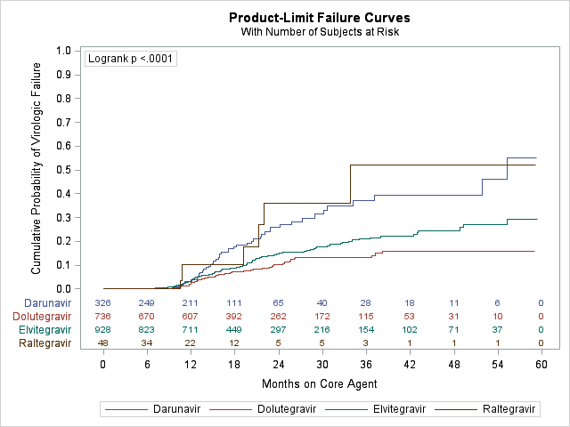
Virologic Failure: Cumulative Probability and Adjusted Hazard Ratio
Notes:
Most failures were failure to achieve suppression within 36 weeks

Slide 17
DISCUSSION

Slide 18
Key Findings
ART-naïve patients with high viral loads initiating on DTG were significantly less likely to experience VF compared to EVG, RAL and DRV initiators even after adjusting for differences in baseline characteristics

Slide 19
Strengths
Limitations
Large sample size in each of the treatment groups with the exception of raltegravir
OPERA cohort is a representative sample of the HIV population receiving care in the United States
  Approximately 7% of all US patients active in care are represented in the database
Electronic medical records:
  Availability of lab results
  Ability to identify and account for history of disorders
Small sample size in raltegravir group
DRV patients differed notably, especially on baseline characteristics associated with risk for treatment failure
OPERA clinical data is collected at point-of-care and is subject to the record-keeping practices of each healthcare provider and each clinic
The latest DHSS recommended agent, bictegravir, and new formulations of raltegravir and darunavir were not included in this study as their approval occurred after the close of study eligibility

Slide 20
Acknowledgements
This research would not be possible without the participation of people living with HIV and their caregivers
Co-authors: Kathy Schulman, Jennifer Fusco, Michael Wohlfeiler, Julie Priest, Alan Oglesby, Laurence Brunet, Phil Lackey, Gregory Fusco
I am grateful for the following contributions: Amelito Torres (SAS programming), Jeff Briney (QA/QC), Rodney Mood (site selection and support), Ted Ising (database architecture and support), Bernie Stooks and Redemptor Perez (database support) and Judy Johnson (medical terminology classification)
This research was supported by ViiV Healthcare

