Slide 2
Oral TLR7 Agonist Administration Induces an Immunostimulatory Response in SIV-Infected ART-Suppressed Infant Rhesus Macaques
Katherine Bricker
@brick_km
Share your thoughts on this presentation with #IAS2019
Notes:
Hello everyone, good afternoon. I would like to start by thanking the organizers for inviting me to speak today. I’m very excited to share some of our recent work with you regarding the immune response to an oral TLR7 agonist, GS-986, in our pediatric model of SIV-infection, ART-suppression.

Slide 3
Disclosures
Accepted free coffee from multiple vendors in Exhibition Hall.
Notes:
This is my disclosure slide.

Slide 4
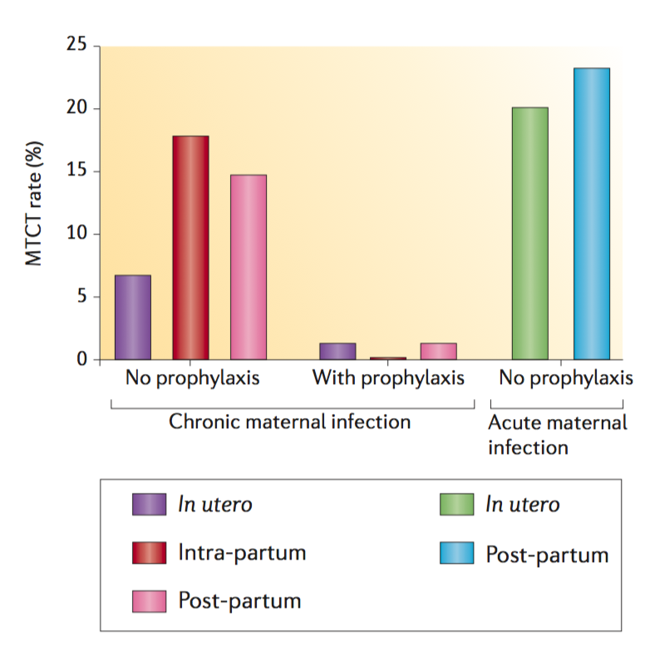
Pediatric HIV-1 Infection
Global estimates for children (<15 years) | 2017
Children living with HIV | 1.8 million [1.3 million – 2.4 million]
New HIV infections in 2017 | 180 000 [110 00-260 000]
UNAIDS/WHO estimates
In the absence of antiretroviral therapy (ART), ~40% of infants born to HIV-infected women acquire infection
Maternal viral loads are a major risk factor in all forms of transmission
  ART is very efficient at reducing transmission!
Over 50% of new pediatric HIV infections occur postnatally, through breast milk
Goulder, Nat Rev Immunol., 2016
Notes:
There are currently nearly 2 million children living with HIV globally and of this number around 180,000 new infections annually.
The most common transmission mode for pediatric infection is through the mother-to-child transmission route which can occur at any stage of pregnancy, during the intrapartum period, or postnatally through breast milk transmission.
In the absence of antiretroviral therapy, or ART, around 40% of infants born to HIV-1 infected women also acquire the infection.
The greatest predictor of mother-to-child-transmission is maternal viral loads and therefore ART is very efficient at reducing transmission.
As shown on this graph, the rate of transmission in mother’s that are receiving ART drops from as high as 15-20% during the intra- or post-partum period to about 1-2% in a virally suppressed mother.
As such, there has been much effort in recent years to increase awareness, screening, and treatment throughout pregnancy and currently over 50% of new pediatric infections occur postnatally, through breastmilk transmission and those transmission rates are highlighted with red arrows on this graph.

Slide 5
To date, ~10 interventional clinical trials targeting HIV reservoirs in infants and children have been initiated, compared to over 80 HIV remission/cure clinical trials in adults.
Notes:
Although there has been a lot of effort put into HIV remission clinical trials in the adult population, there has been little focus clinically on pediatric cure or remission with only 10 clinical trials targeting the HIV reservoir initiated in infants and children compared to over 80 “cure” clinical trials in the adult population.

Slide 6
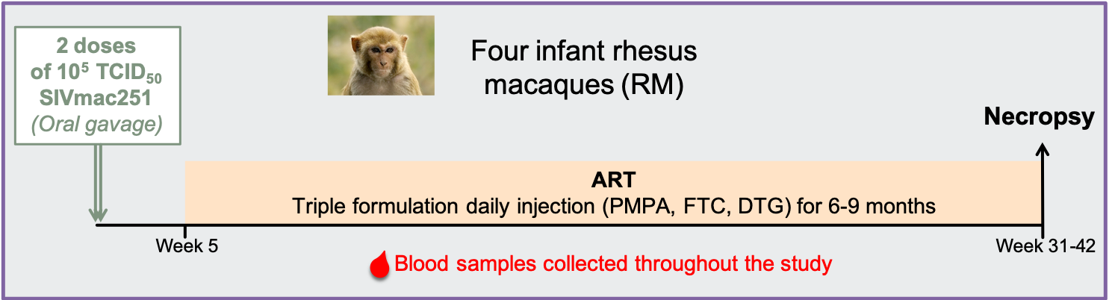
Establishment of a pediatric SIV oral transmission and ART suppression model in infant macaques
Mavigner, J Virol., 2018
Notes:
Establishing a model of postnatal oral HIV-1 transmission and ART suppression in the rhesus macaque has been a priority in the Chahroudi lab. In a published pilot study, four infant macaques were challenged with two doses of SIVmac251 via oral gavage and ART was initiated at 5 weeks-post infection.
Blood was collected at scheduled intervals and plasma viral loads, serum chemistry, complete blood count, and immunological parameters were monitored throughout the study. After 6 to 9 months of ART, animals underwent elective necropsy and tissue was collected for extensive analysis.
In this study, we saw that ART was well-tolerated and efficient at inducing viral suppression below the limit of detection of our virological assay. A significant decline in SIV DNA in peripheral CD4+ T cells was also observed in all animals on ART compared to their pre-ART SIV DNA levels.
From this pilot study we concluded that this model of oral SIV infection simulates postnatal HIV-1 infection through breastfeeding with ART-mediated suppression of viremia to permit characterization of SIV persistence and for evaluation of potential therapeutic interventions in infant rhesus macaques.

Slide 7
TLR7 Agonist Background
TLR7 stimulation through GS-986 in combination with therapeutic vaccination (Ad26/MVA) improves virologic control and delays viral rebound following discontinuation of ART in adult SIV-infected rhesus macaques.
Borducchi, Nature, 2016
Administration of a broadly neutralizing antibody with a TLR7 agonist (GS-9620) delay viral rebound in adult SHIV-infected rhesus macaques.
Borducchi, Nature, 2018
For the study, we sought to evaluate tolerability and pharmacodynamic responses to this TLR7 agonist GS-986 in our infant rhesus macaque model of SIV infection/ART suppression.
Notes:
We were interested in testing the potential therapeutic GS-986, an oral TLR7 agonist, in our pediatric SIV/ART model because of the success it has shown in recent studies involving adult macaques.
When used in combination with therapeutic vaccination animals displayed enhanced virologic control and experienced a delay in viral rebound following interruption of ART.
Additionally, in a more recent study involving adult SHIV-infected macaques, TLR7 stimulation through GS-9620, the clinical analog to the investigational tool compound GS-986, along with administration of a broadly neutralizing antibody, PGT121, resulted in delayed viral rebound.
For the study that I will present today, we sought to evaluate the tolerability and pharmacodynamic response to GS-986 in our infant rhesus macaque model of oral SIV infection and ART suppression.

Slide 8
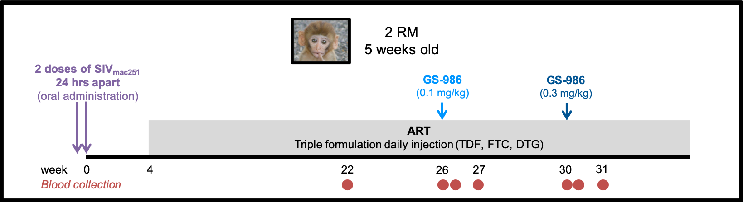
TLR7 agonist GS-986 oral administration in SIV-infected ART-suppressed infant macaques
Main Objective: To test the tolerability and pharmacodynamic responses of the TLR7 agonist GS-986 in SIV-infected infant rhesus macaques virologically suppressed with ART.
Notes:
In this study, two infant macaques were challenged with SIVmac251 via oral administration at 5 weeks of age. A triple formulation consisting of Tenofovir, Emtricitabine, and Dolutegravir was initiated at 4-weeks post infection and administered daily. Blood was collected regularly to monitor plasma viral loads, serum chemistry, CBC, and immune activation.
After 14-18 weeks of viral suppression animals received a 0.1 mg/kg dose of GS-986 via oral gavage. Blood was collected pre-administration and then again at 24-hours and 1-week post-administration for flow cytometry, plasma cytokine analysis, and to monitor viral loads, CBC, and serum chemistries.
Following 4-weeks of rest, both animals received a second dose of GS-986 at 0.3 mg/kg again by oral gavage and analysis were repeated at the same time points.
An overview of the schematic is highlighted on this slide.

Slide 9
GS-986 is well-tolerated in infant macaques
Notes:
We found that oral GS-986 was well tolerated in the infant macaques at both doses. Animals continued to gain weight throughout the study. White blood cell counts, hemoglobin, and platelet count all remained within expected parameters. Kidney and liver functions also remained normal throughout indicated by serum chemistry.

Slide 10
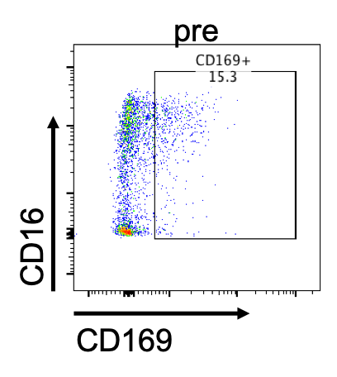
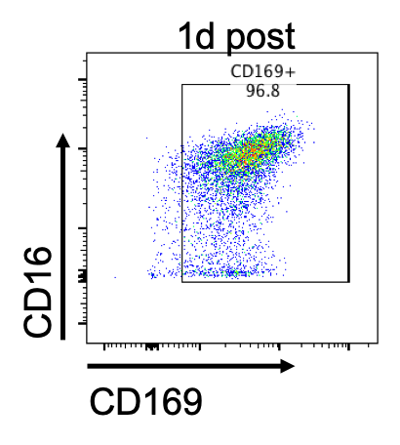
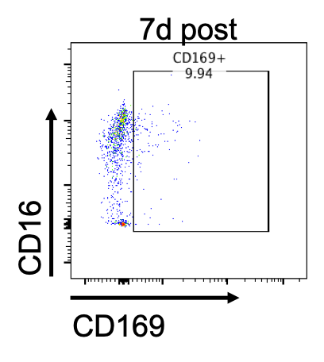
Oral GS-986 results in robust transient monocyte activation
Notes:
Through flow cytometry, we also monitored monocyte activation following GS-986 administration. At 24-hours following both the 0.1 mg/kg and the 0.3 mg/kg dose we saw a dramatic increase in both monocyte activation, measured through increased CD16 expression and graphed on the left of this slide, and circulating macrophages, measured through CD169 expression displayed on the right. By 7-day post administration both CD16 and CD169 had returned to baseline, pre-dose levels. A representative flow cytometry plot is displayed on the bottom of this slide.

Slide 11
Increase of plasma cytokines and chemokines is observed following oral GS-986
Notes:
Using a multiplex array we also measured plasma cytokine and chemokine concentrations throughout the study. A dose dependent increase of plasma IL-1RA, IP-10, and I-TAC was observed in both animals at 24-hours post GS-986 administration with the biggest flux observed in IL-1RA concentrations. By 7 days post administration, all had returned to baseline levels.

Slide 12
Increase of plasma cytokines and chemokines is observed following oral GS-986
IFN-γ (pg/ml)
IFN-α (pg/ml)
Notes:
While no change was observed at the 0.1 mg/kg dose of GS-986, we did observed increased IFN-gamma, IL-6, IL-8, and IFN-alpha by 24 hours following the 0.3 mg/kg dose with a return to baseline by the 7 day post-administration time point.

Slide 13
Oral GS-986 results in a transient increase of peripheral CD4+ T cell frequency
Notes:
Through whole blood flow cytometry we also monitored T cell kinetics and saw a transient increase in peripheral CD4+ T cell frequency at 24 hours post-administration and a drop back to pre-dose frequency by 1 week.
Expand on the why??
Previous adult studies have observed a decrease in peripheral CD4+ T cell frequency 4-6 hours following oral TLR7 stimulation so we believe that the increase we are observing is a rebound from CD4+ T cells leaving the periphery to enter tissues.

Slide 14
No plasma viremia was detected during TLR7 agonist administration
Notes:
Finally, we quantified plasma viral loads by real-time RT-PCR in both infants and with these two doses, in these two animals we did not observe plasma viremia.

Slide 15
Conclusions
GS-986 was well tolerated in SIV-infected ART-suppressed infant rhesus macaques.
GS-986 induced expected pharmacodynamic responses with transient immune activation including monocyte activation and increased plasma cytokines and chemokines in SIV-infected ART-suppressed infant rhesus macaques.
These results add new information to existing data on GS-986 for potential future application of an oral TLR7 agonist to treat children living with HIV-1.
Notes:
In conclusion, our pilot study demonstrates that GS-986 is well tolerated in our infant macaque model of SIV infection and ART suppression at both tested doses with induction of expected pharmacodynamic responses.
We observed transient immune activation through both monocyte activation and increased cytokines and chemokine concentration in the plasma at levels similar to what has been reported previously in the adult macaque studies.
And finally, these results add important new information to the existing data on GS-986 for potential future applications of an oral TLR7 agonist to treat children living with HIV-1.

Slide 16
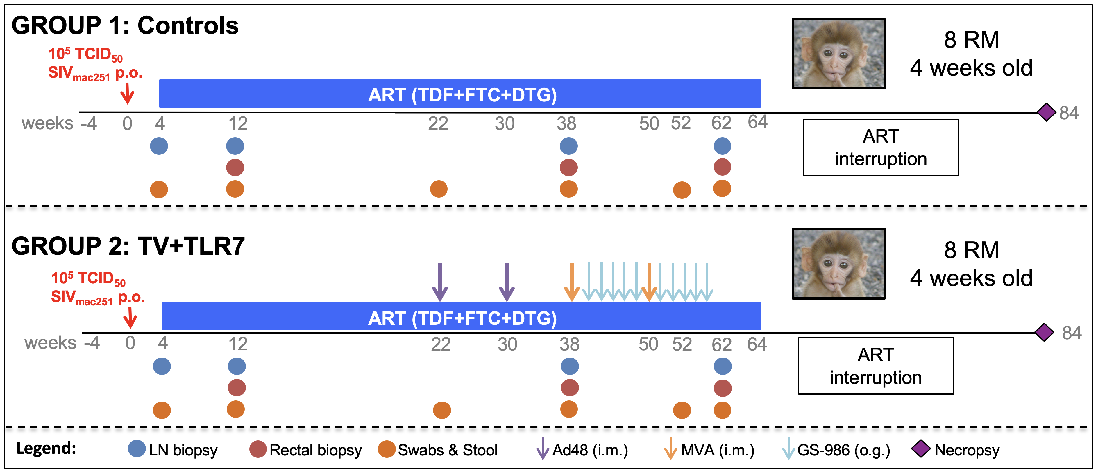
Future Directions
Ongoing work involves investigating the effect of GS-986 with a therapeutic vaccine on viral reservoir and viral rebound following analytical treatment interruption in SIV-infected ART-suppressed infant macaques.
Notes:
Ongoing work in our lab includes a larger study investigating the effect of GS-986 in combination with a therapeutic vaccine on the viral reservoir and viral rebound kinetics following analytical treatment interruption in SIV-infected ART-suppressed infant macaques. The schematic design and plasma viral loads of these infants are represented on this slide.

Slide 17
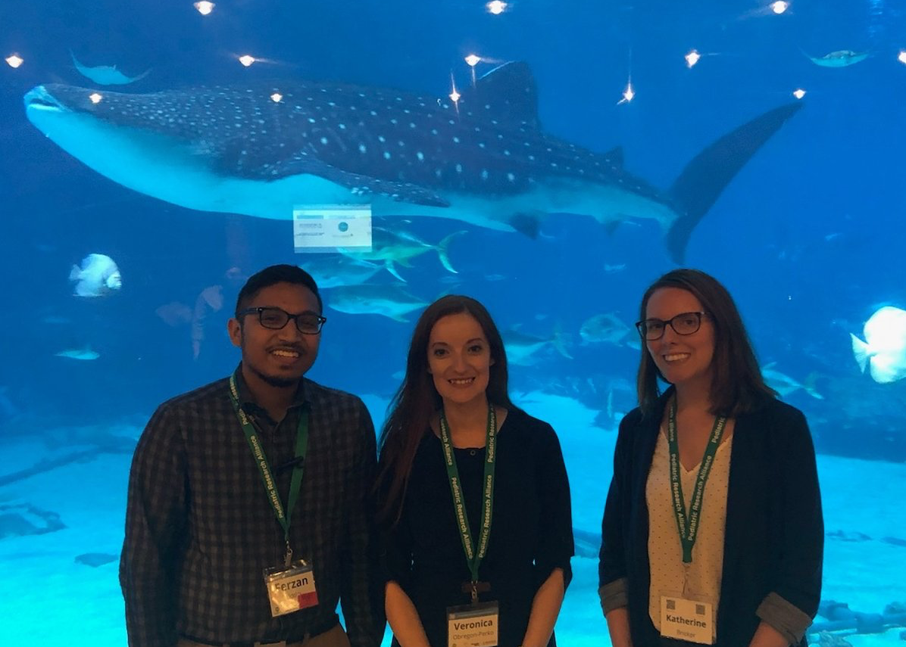
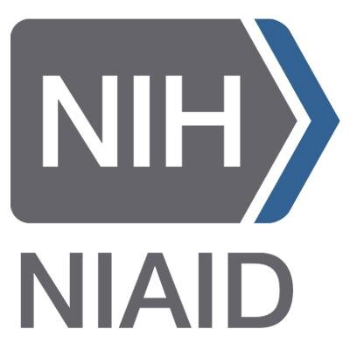

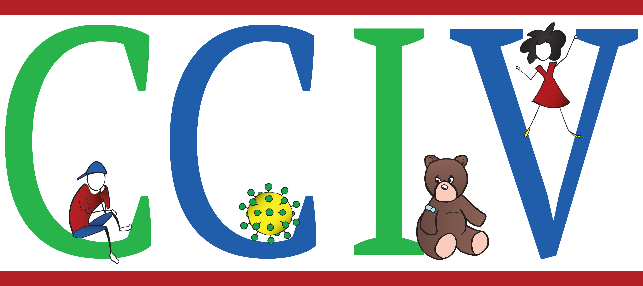


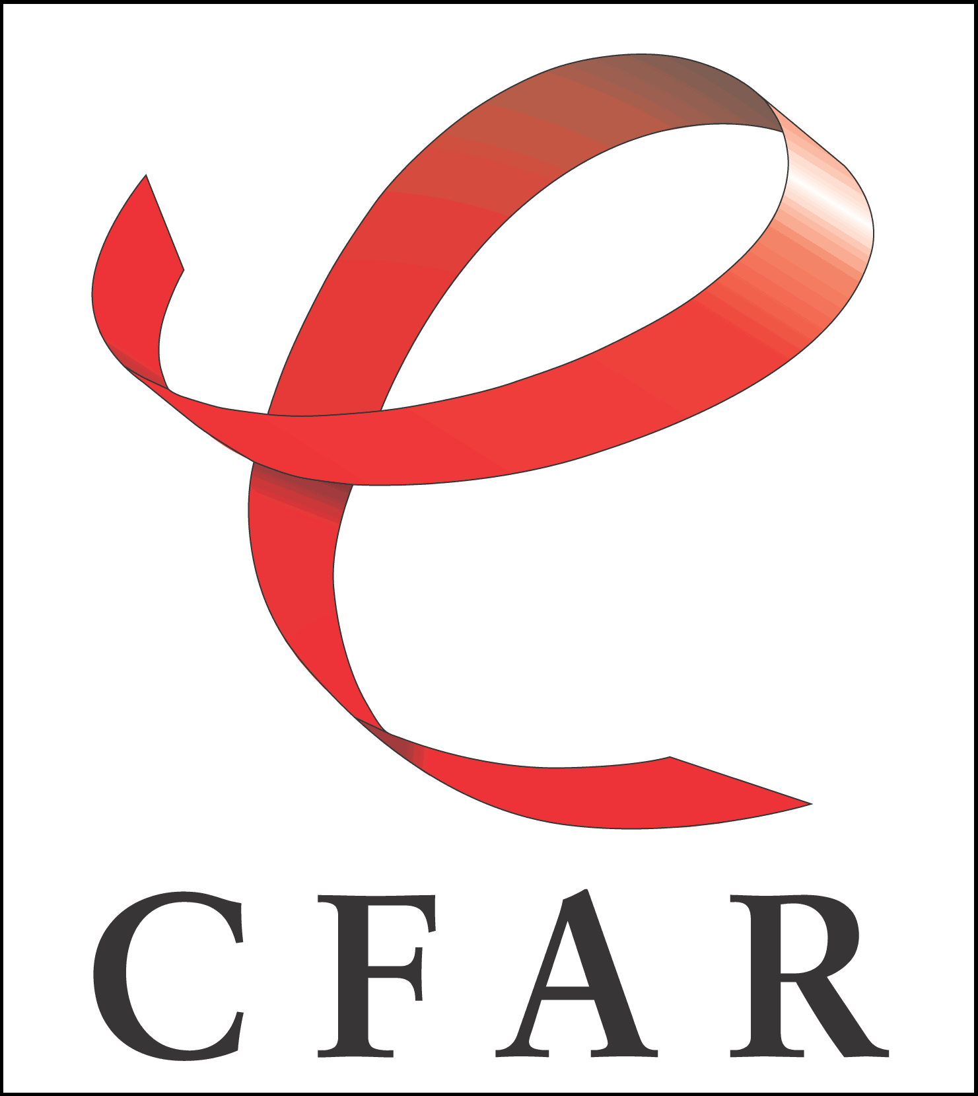
Acknowledgments
Chahroudi Lab
Maud Mavigner
Veronica Obregon-Perko
Ferzan Uddin
Amir Dashti
Vidisha Singh
Nils Schoof
Cameron Mattingly
Alyssa Brooks
Chevaughn Waller
Brianna Williams
YNPRC:
Sherrie Jean
Stephanie Ehnert
BIDMC:
Dan Barouch
MHRP:
Nelson Michael
Merlin Robb
CFAR Virology Core:
Shan Liang
Shelly Wang
Thomas Vanderford
Emory Collaborators:
Guido Silvestri
Mirko Paiardini
Rama Amara
Cindy Derdeyn
Jens Wrammert
Gilead:
Joseph Hesselgesser
Pediatrics/Winship FCC:
David Archer
Aaron Rae
New Iberia Research Center:
Francois Villinger
R01 AI33706
Notes:
With that I would like to conclude by thanking our lab. I’d also like to thank our collaborators, specifically at Gilead for providing both GS-986 and the ART drugs and also for reviewing and providing feedback for these slides. I’d also like to thank our many other collaborators both at Emory and elsewhere, the Yerkes research services staff for taking care of the monkeys, the monkeys themselves, and our funding sources.

Slide 18
Thank you!
Notes:
And finally, thank you for your attention.

