Slide 1
Vesatolimod (GS-9620) Is Safe and Pharmacodynamically Active in HIV-Infected Individuals
Sharon A. Riddler¹, Michael Para², Constance A. Benson³, Anthony Mills⁴, Moti Ramgopal⁵, Edwin DeJesus⁶, Cynthia Brinson⁷, Joshua Cyktor¹, John Mellors¹, Susan Guo⁸, Brian Doehle⁸, Svetlana Markova⁸, Heena Patel⁸, Hiba Graham⁸, Joseph Hesselgesser⁸, Romas Geleziunas⁸, Diana Brainard⁸, Scott McCallister⁸, Devi SenGupta⁸
¹University of Pittsburgh, Department of Medicine, Pittsburgh, Pennsylvania, USA; ²The Ohio State University, Wexner Medical Center, Columbus, Ohio, USA; ³University of California San Diego, Department of Medicine, San Diego, California, USA; ⁴SoCal Men's Medical Group, Los Angeles, California, USA; ⁵Midway Specialty Care Center, Fort Pierce, Florida, USA; ⁶Orlando Immunology Center, Orlando, Florida, USA; ⁷Central Texas Clinical Research, Austin, Texas, USA; ⁸Gilead Sciences, Inc., Foster City, California, USA
IAS, 21–24 July 2019, Mexico City, Mexico

Slide 2
Disclosures
Dr. Riddler has received grant support from Gilead (for the current project) and GlaxoSmithKline.

Slide 3
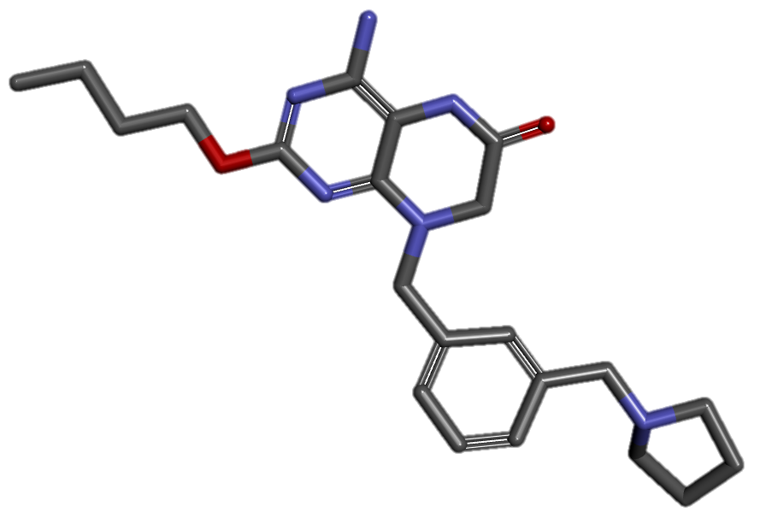
Immune-Based Strategies to Eliminate HIV Reservoirs
Protect
Vesatolimod
(TLR7 agonist)
ART
Activate
Eliminate
Infected CD4 T cells
bNAb
Vaccines
Vesatolimod
(TLR7 agonist)
Recruit
immune
cells
NK cells
MΦs
T cells
Goal
Combine TLR7 agonist, bNAbs, therapeutic vaccine
ART, antiretroviral therapy; bNAb, broadly neutralizing antibody; MΦs, macrophages; NK, natural killer; TLR7, toll-like receptor-7.

Slide 4
Proof of Concept in Nonhuman Primate Model
Modified from Borducchi E, et al. Nature 2018;563:360-4.
TLR7 + bNAb
Modified from Borducchi E, et al. Nature 2016;540:284-7.
TLR7 + Vaccine
7
7
6
6
3/9 Controllers
5/11 No Rebound
5
5
Log SHIV RNA Copies/mL
Log SIV RNA Copies/mL
4
4
3
3
2
2
0
20
40
60
80
100
120
140
160
0
20
40
60
80
100
120
140
160
Days following ART discontinuation
Days following ART discontinuation
SHIV, simian/human immunodeficiency virus; SIV, simian immunodeficiency virus.

Slide 5
Vesatolimod Dose Escalation Study in PLWH
1 mg x 6
PLWH on ART
N=48
2 mg x 6
Randomized 6:2
4 mg x 6
VES:PBO PO, fasted
Every other week
6 mg x 10
8 mg x 10
10 mg x 3→12 mg x 7 doses
Key inclusion criteria:
CD4 count ≥400 cells/μL
HIV-1 RNA levels <50 copies/mL x ≥1 year
Pre-ART CD4 nadir ≥200 cells/μL
Objectives:
Safety, PK
PD parameters:
ISG, cytokines, cell activation
Virology:
Plasma HIV RNA
NCT02858401
PLWH: People Living with HIV; ISG, interferon-stimulated gene; PBO, placebo; PD, pharmacodynamics; PK, pharmacokinetics; VES, vesatolimod.

Slide 6
Vesatolimod Dose Escalation: Design and Assessments
Week
1
2
3
4
5
6
7
8
9
10
11
12
13
14
15
16
17
18
19
20
21
22
VES Dosing
+ ART
VES 1, 2, 4 mg x 6 doses
VES 6, 8, 10/12 mg cohort x 10 doses
CD4, Plasma HIV-1 RNA
HIV DNA, ELISpot*, flow*
ISG, cytokines, cell activation
VES PK
*Measurement of HIV specific T-cell responses

Slide 7
Baseline Demographic and Disease Characteristics
 | PBO n=12 | 1 mg n=6 | 2 mg n=6 | 4 mg n=6 | 6 mg n=6 | 8 mg n=6 | 10/12 mg n=6
Median age, y (range) | 47 (26-62) | 46 (28-58) | 45 (27-58) | 54 (43-57) | 45 (28-55) | 45 (31-60) | 53 (23-66)
Male, n | 12 | 6 | 5 | 6 | 6 | 3 | 5
Median CD4, cells/mm³ | 624 | 875 | 658 | 504 | 757 | 676 | 814
Median time from Dx to ART, y | 1 | 3 | 6 | 2 | 1 | 2 | 1
Median total time on ART, y | 10 | 5 | 6 | 11 | 5 | 4 | 14
Median Pre-ART VL (log10 copies/mL) | 5.34 | 4.35 | 4.64 | 4.48 | 5.17 | 3.48 | 4.01
Dx, diagnosis.

Slide 8
Safety

Slide 9
Overall Safety
Participants, n (%) | PBO n=12 | 1 mg n=6 | 2 mg n=6 | 4 mg n=6 | 6 mg n=6 | 8 mg n=6 | 10/12 mg n=6
Any grade AE | 9 (75) | 4 (67) | 4 (67) | 2 (33) | 4 (67) | 5 (83) | 4 (67)
Grade 2 | 2 (17) | 3 (50) | 2 (33) | 1 (17) | 1 (17) | 2 (33) | 1 (17)
Study drug-related AE | 2 (17) | 0 | 1 (17) | 1 (17) | 1 (17) | 3 (50) | 3 (50)
1 Grade 3 AE (abdominal pain) and 1 serious AE (diverticulitis; 2 mg cohort)
Both unrelated to study drug and occurring in same participant
No discontinuations due to AEs; no Grade 4 AEs; no deaths

Slide 10
Common Adverse Events (> 1 participant by cohort)
Participants, n (%) | PBO n=12 | 1 mg n=6 | 2 mg n=6 | 4 mg n=6 | 6 mg n=6 | 8 mg n=6 | 10/12 mg n=6
Any AE | 9 (75) | 4 (67) | 4 (67) | 2 (33) | 4 (67) | 5 (83) | 4 (67)
Cough | 3 (25) | 1 (17) | 0 | 1 (17) | 1 (17) | 0 | 0
Headache | 2 (17) | 1 (17) | 1 (17) | 0 | 0 | 1 (17) | 1 (17)
Fatigue | 3 (25) | 2 (33) | 0 | 1 (17) | 1 (17) | 0 | 3 (50)
Nausea | 1 (8) | 2 (33) | 1 (17) | 0 | 0 | 1 (17) | 1 (17)
Myalgia | 1 (8) | 0 | 0 | 0 | 2 (33) | 1 (17) | 1 (17)
Sinus Congestion | 1 (8) | 2 (33) | 1 (17) | 0 | 1 (17) | 0 | 0
URI | 0 | 0 | 0 | 0 | 0 | 2 (33) | 0
URI: upper respiratory tract infection

Slide 11
Laboratory Abnormalities
Participants, n (%) | PBO n=12 | 1 mg n=6 | 2 mg n=6 | 4 mg n=6 | 6 mg n=6 | 8 mg n=6 | 10/12 mg n=6
Grade 1 | 7 (58) | 5 (83) | 5 (83) | 3 (50) | 3 (50) | 3 (50) | 3(50)
Grade 2 | 2 (17) | 1 (17) | 0 | 1 (17) | 2 (33) | 2 (33) | 1 (17)
Grade 3 | 0 | 0 | 0 | 0 | 0 | 0 | 1 (17)ª
Grade 4 | 0 | 0 | 0 | 0 | 0 | 1 (17)^{b} | 1 (17)^{b}
Participants were counted once for the maximum severity for each laboratory test.
ª Participant with hematuria with confirmed menses; ^{b} Participants with elevated creatinine kinase due to strenuous exercise
No dose dependent trends in lab abnormalities

Slide 12
Pharmacokinetics

Slide 13
Pharmacokinetics
1 mg
2 mg
4 mg
6 mg
8 mg
10 mg
12 mg
VES plasma
concentration, pg/mL
VES
*
Time, h
VES was rapidly absorbed (T_{max} 1-4 hours)
Exposure was generally dose proportional
*Below limit of quantification at 48 hours

Slide 14
Pharmacodynamics

Slide 15
NK Cell Activation
NK Cells CD69+, %
1st administration at each dose level shown
Similar trends observed in CD4 and CD8 T lymphocytes

Slide 16
Circulating Cytokines
IL-1RA
IP-10
ITAC
6 mg
8 mg
10 mg
12 mg
Dose 1
Dose 5
Dose 10
Dose 1
Dose 5
Dose 10
Dose 1
Dose 5
Dose 10
Absolute Change
Median Induction, pg/mL (IQR)
Days
Days
Days
IL-1RA, interleukin 1 receptor antagonist; IP-10, IFN gamma-induced protein 10; ITAC, IFN-inducible T-cell-α chemoattractant

Slide 17
Induction of ISG15 mRNA
Participants, n=36
Dose
1
2
3
4
5
6
10
4
10/12 mg
3
1
1
2
3
4
5
6
10
8 mg
5
1
1
2
3
4
5
6
10
6 mg
5
1
1
2
3
4
5
6
6
ISG15 fold change (by cohort)
4 mg
4
1
1
2
3
4
5
6
6
2 mg
4
1
1
2
3
4
5
6
6
1 mg
4
1
Placebo
White cells are missing data
ISG, Interferon-stimulated gene

Slide 18
Virologic Assessments

Slide 19
Virologic Results
 | PBO n=12 | 1 mg n=6 | 2 mg n=6 | 4 mg n=6 | 6 mg n=6 | 8 mg n=6 | 10/12 mg n=6
Any pVL > 20 copies/mL, n | 8 | 2 | 1 | 2 | 1 | 0 | 3
pVL range, copies/mL | 21-2430 | 21–42 | 21 | 23–69 | 32 | - | 24–27
Most occurrences of plasma viral load elevations > 20 copies/mL were isolated
No evidence of changes in plasma HIV RNA by single copy assay, or in total cell-associated HIV DNA or HIV RNA
pVL, plasma viral load.

Slide 20
Conclusions
In this placebo controlled, phase 1 study in PLWH:
Multiple doses of VES 1-12 mg were well tolerated
Plasma exposure of VES was generally dose proportional
Immune stimulation was evident at ≥ 6 mg doses
Cellular activation markers, plasma cytokine increases and ISG mRNA induction
No obvious changes in virologic markers
Trials evaluating the efficacy of VES, alone and in combination with other agents, are in progress

Slide 21
Acknowledgments
We extend our thanks to the study participants and investigators.
This study was funded by Gilead Sciences Inc.

