Slide 1
Renal function trajectories after switching from TDF to TAF
A nationwide cohort study
Bernard Surial, Bruno Ledergerber, Alexandra Calmy, Matthias Cavassini, Huldrych Günthard, Helen Kovari, Marcel Stöckle, Enos Bernasconi, Pietro Vernazza, Christoph Fux, Hansjakob Furrer, Andri Rauch, Gilles Wandeler, and the Swiss HIV Cohort Study (SHCS)
@b_surial
Share your thoughts on this presentation with #IAS2019

Slide 2
Disclosures
Received travel grant from Gilead sciences, paid to my home institution

Slide 3
Rationale and aims of the study
Background
Improved renal safety of tenofovir alafenamide (TAF) vs tenofovir disoproxil fumarate (TDF) were shown in registration trials
Real world data in patients with impaired renal function and co-morbidities at initiation of TAF are lacking
Aims
To evaluate the impact of switching from TDF to TAF on eGFR and proteinuria
To identify subgroups who benefit most from switching from TDF to TAF

Slide 4
Methods
Swiss HIV Cohort Study (SHCS): ~80% of HIV-infected adults on ART in Switzerland
Inclusion criteria for the present study:
  Patients were either on TDF until the end of the observation period* (TDF Group) OR switched from TDF to TAF and remained on it (TAF Group)
  Had ≥ 2 creatinine measurements before and after baseline date** (≥ 1 month apart)
Statistics: linear mixed-effect regression and multivariable logistic regression, adjusted for potential confounders, including co-morbidities, co-infections, co-medications
* March 2019
**Baseline date defined as date of switch (TAF group) or 01. Oct. 2016 (TDF group)

Slide 5
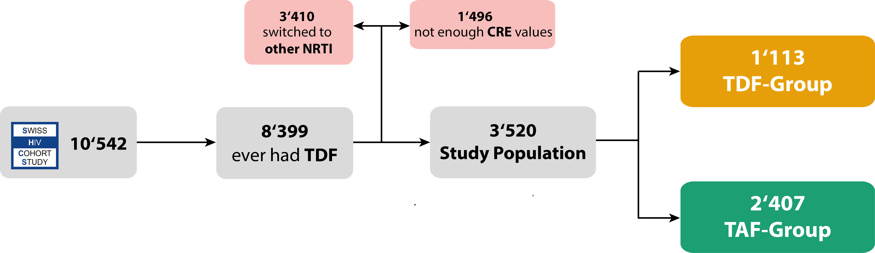
Patient Flow

Slide 6
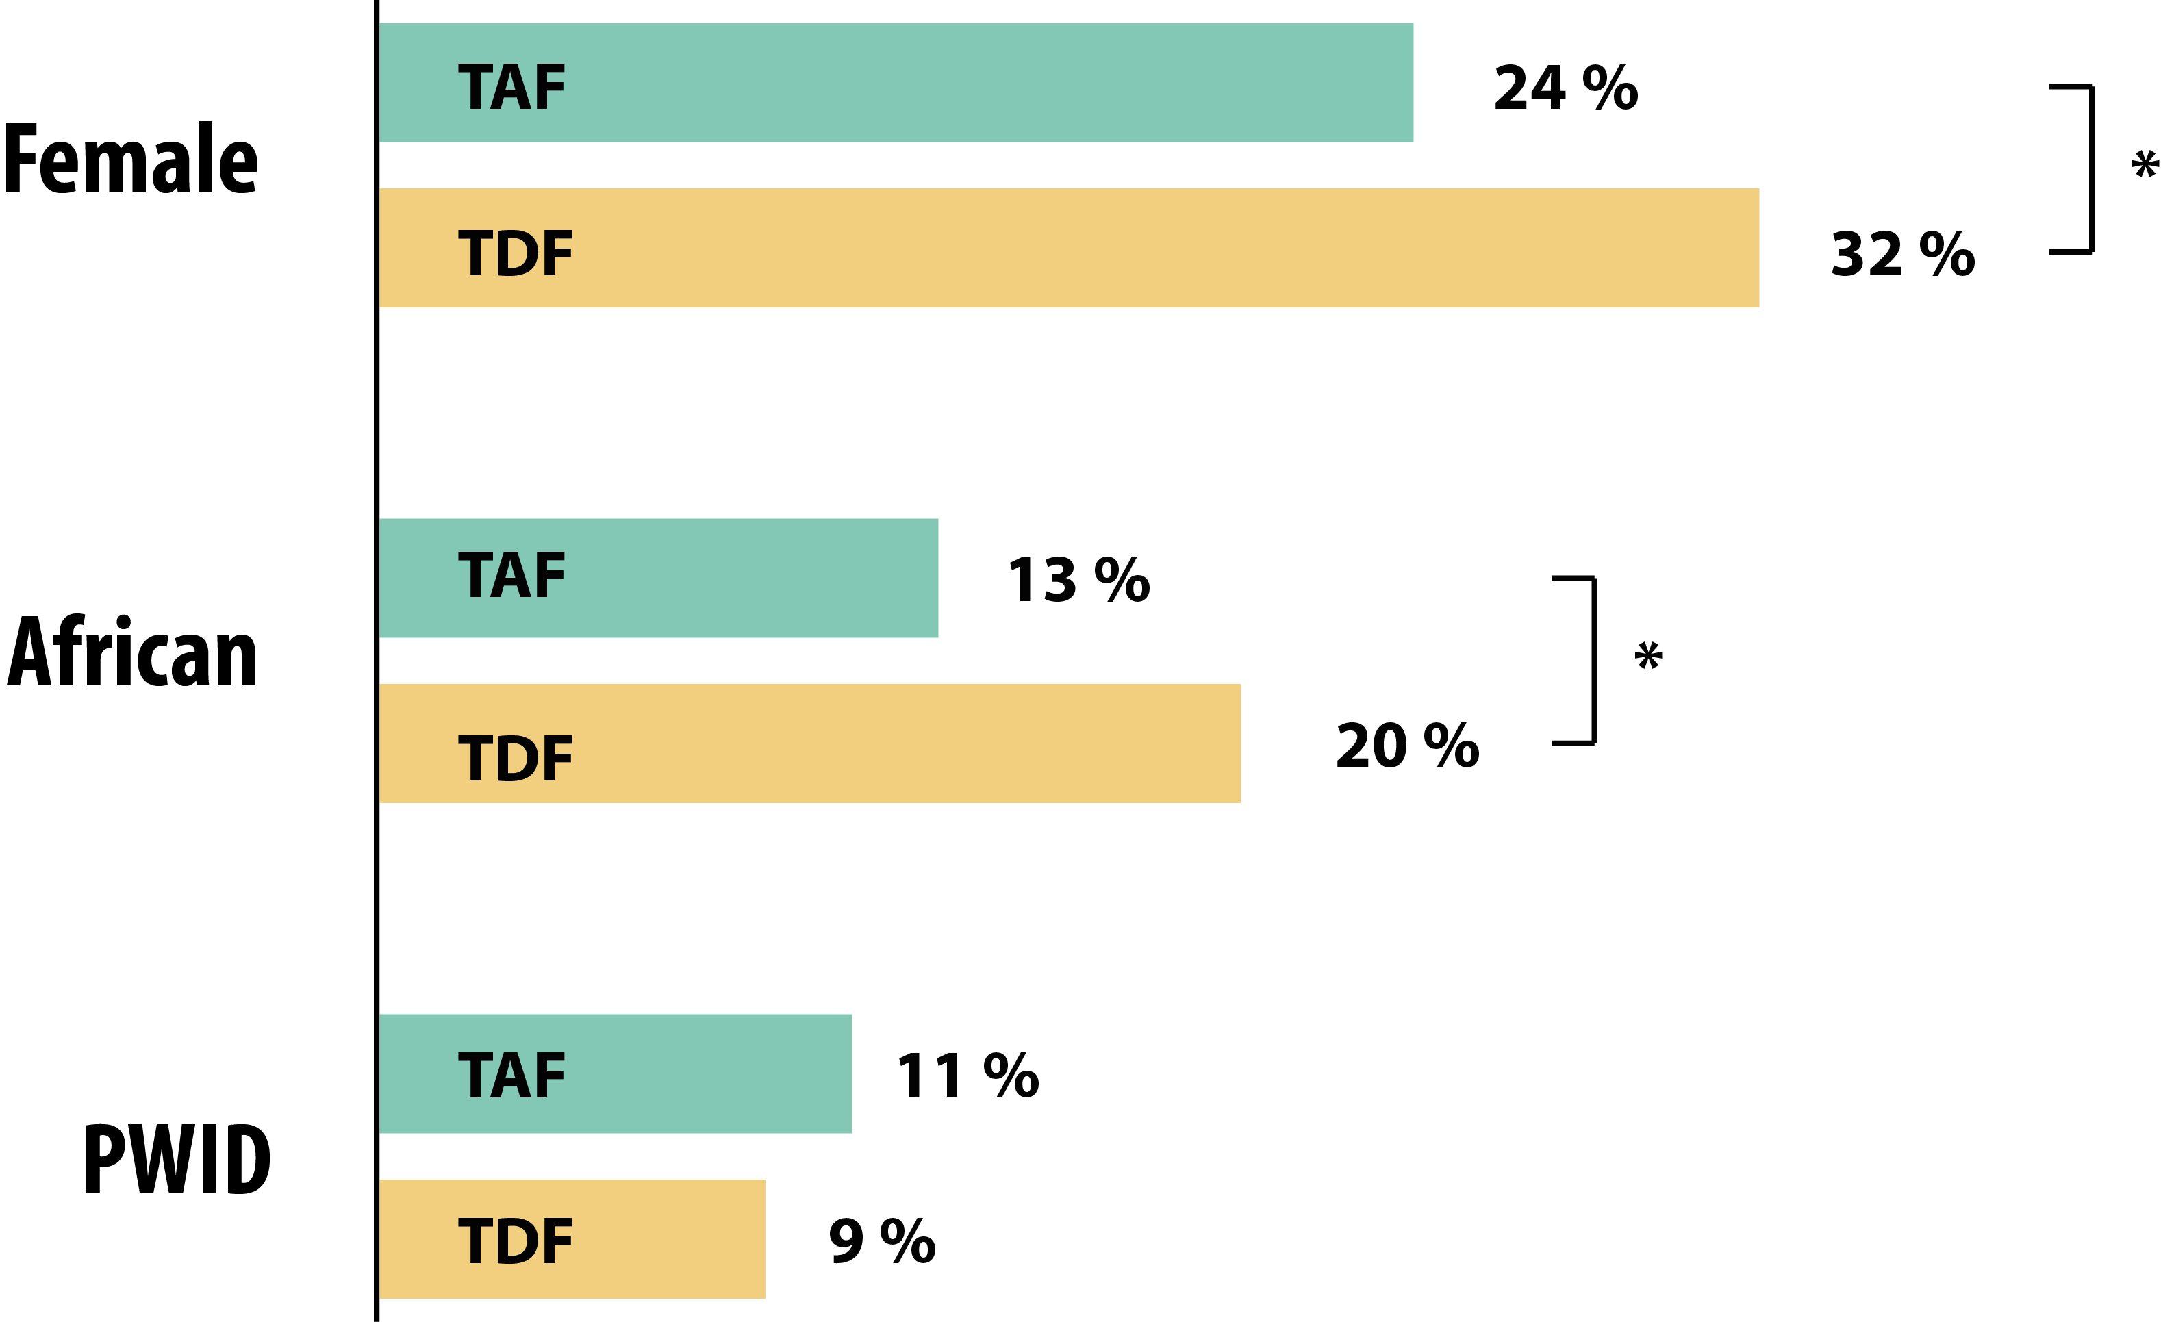
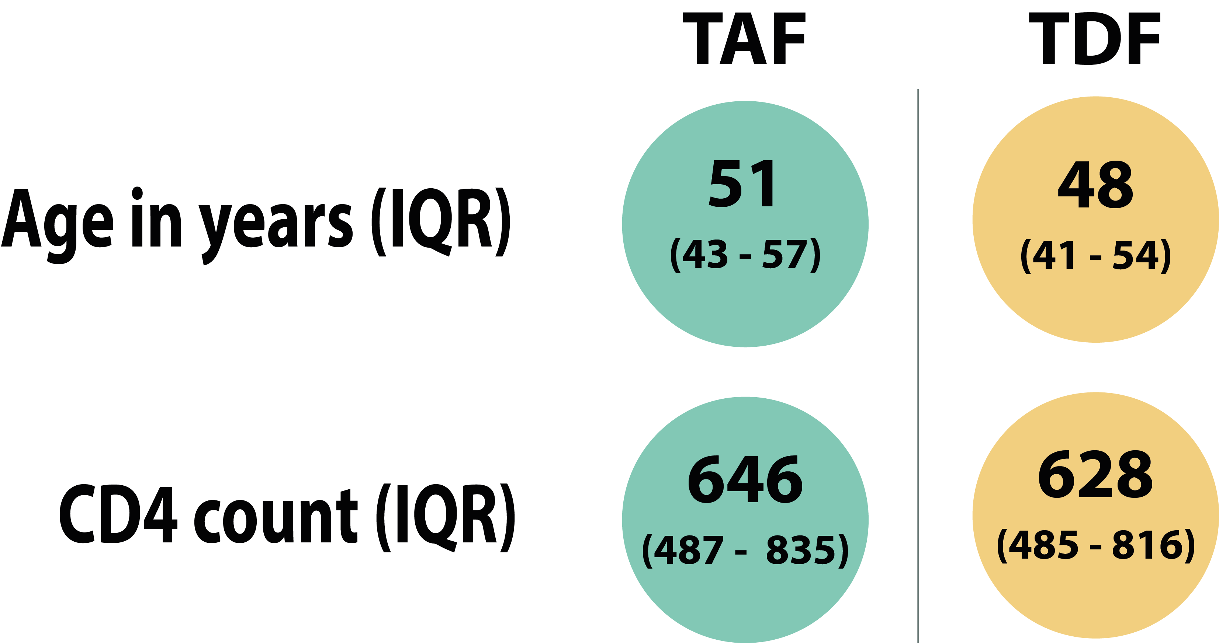
Patient Characteristics

Slide 7
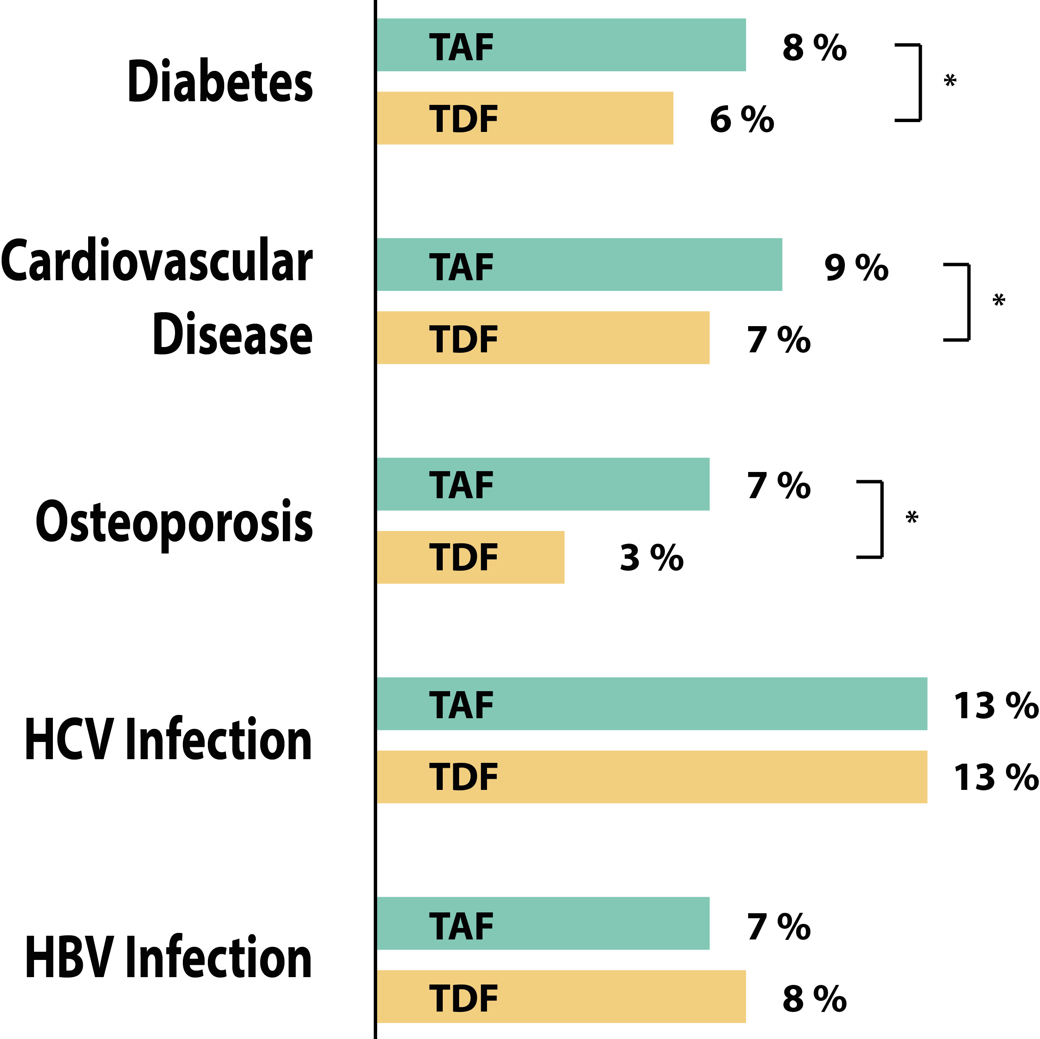
Co-Morbidities

Slide 8
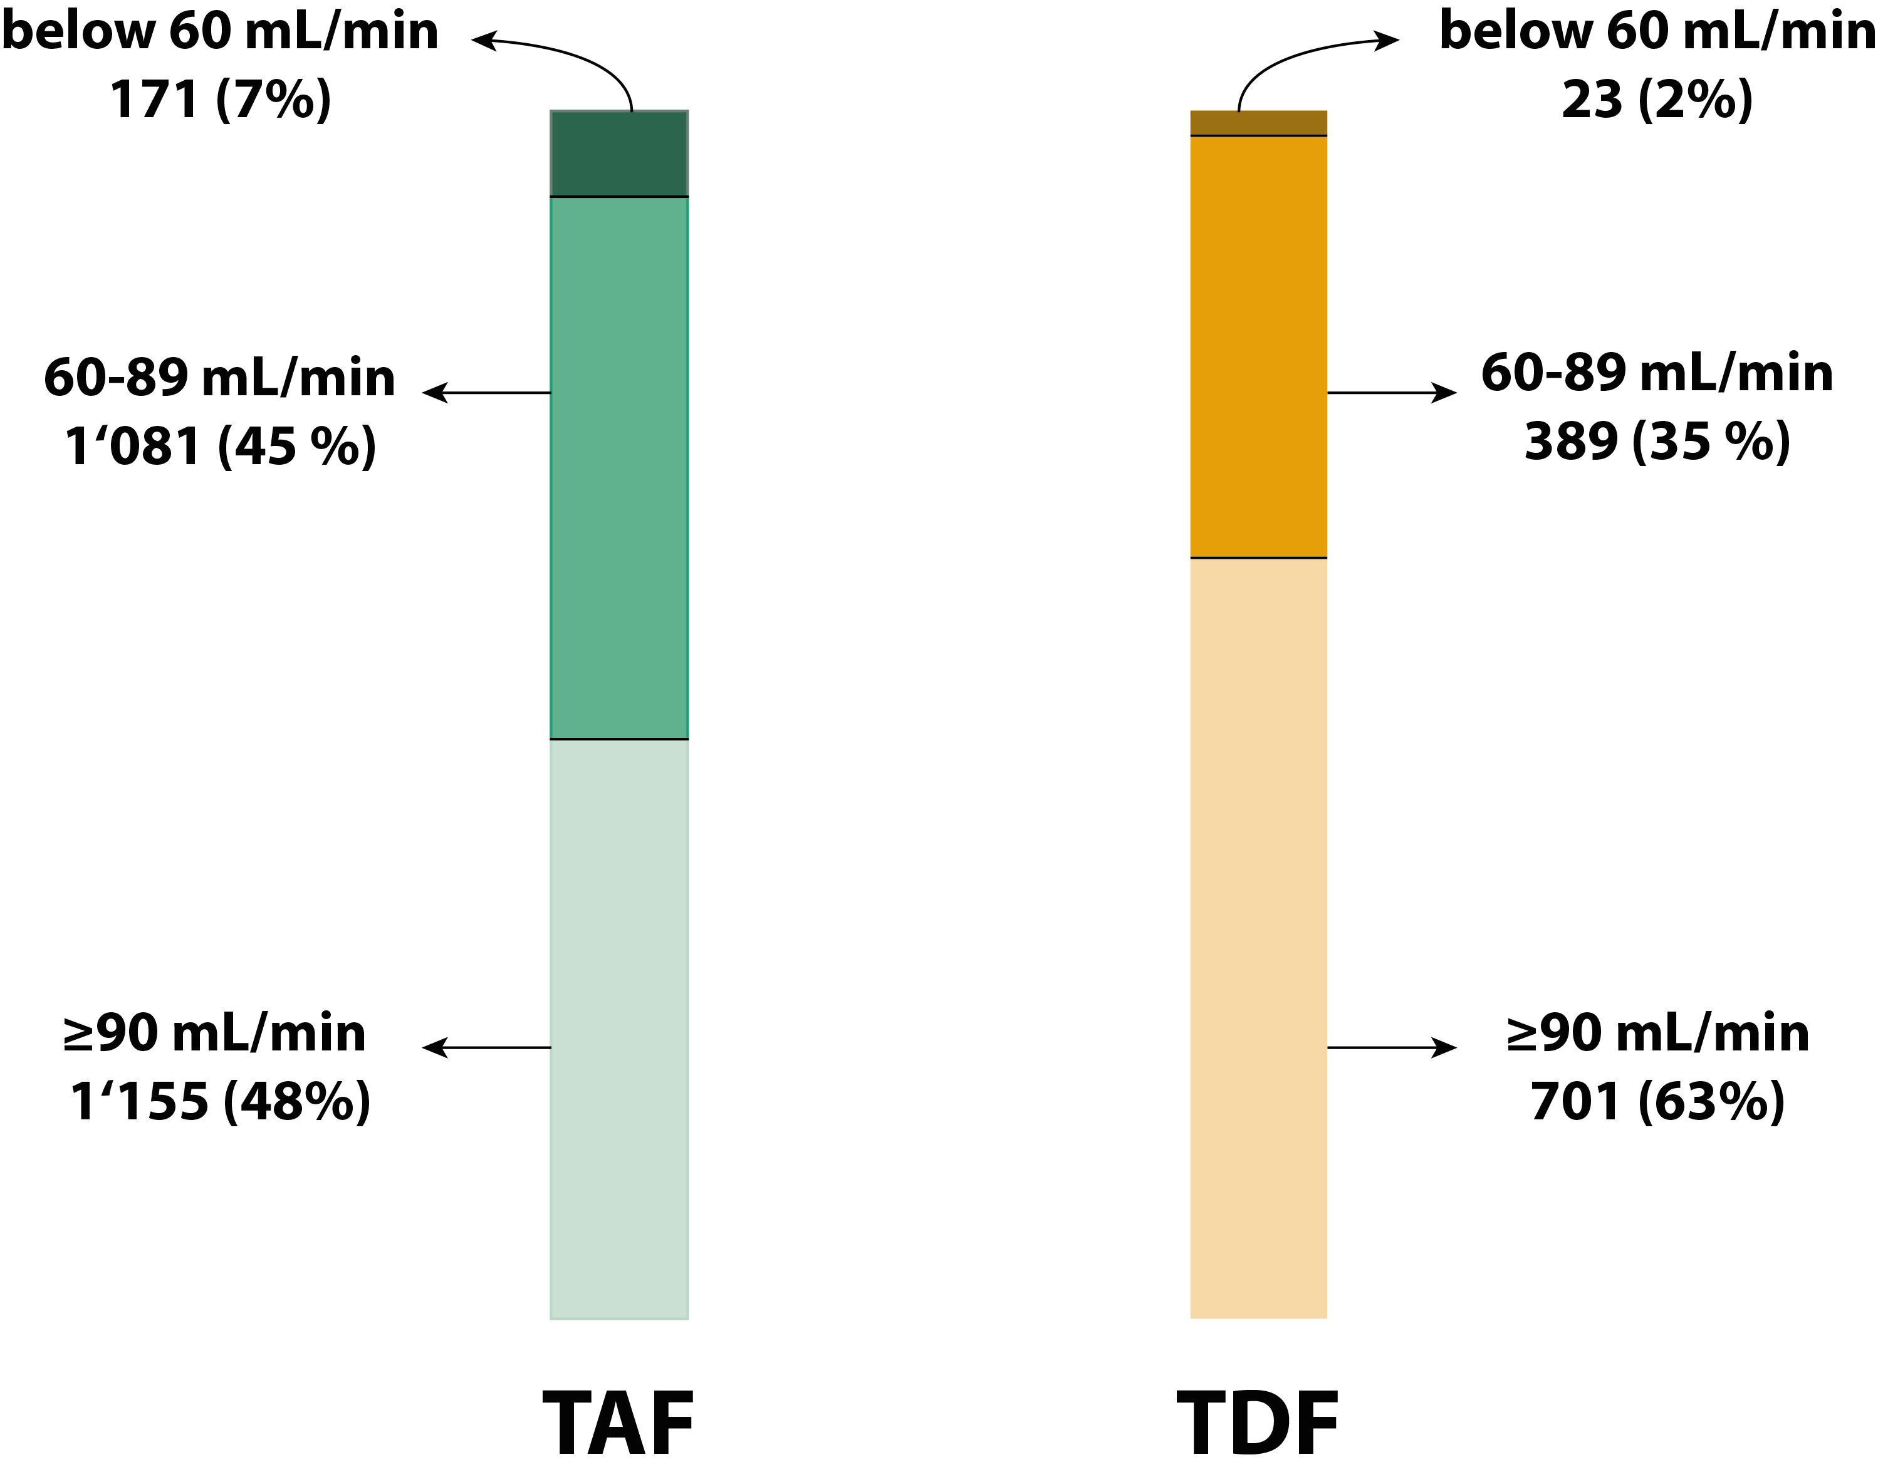
eGFR at baseline
Normal ≥ 90mL/min
Mild 60-89 mL/min
Moderate to Severe below 60 mL/min

Slide 9
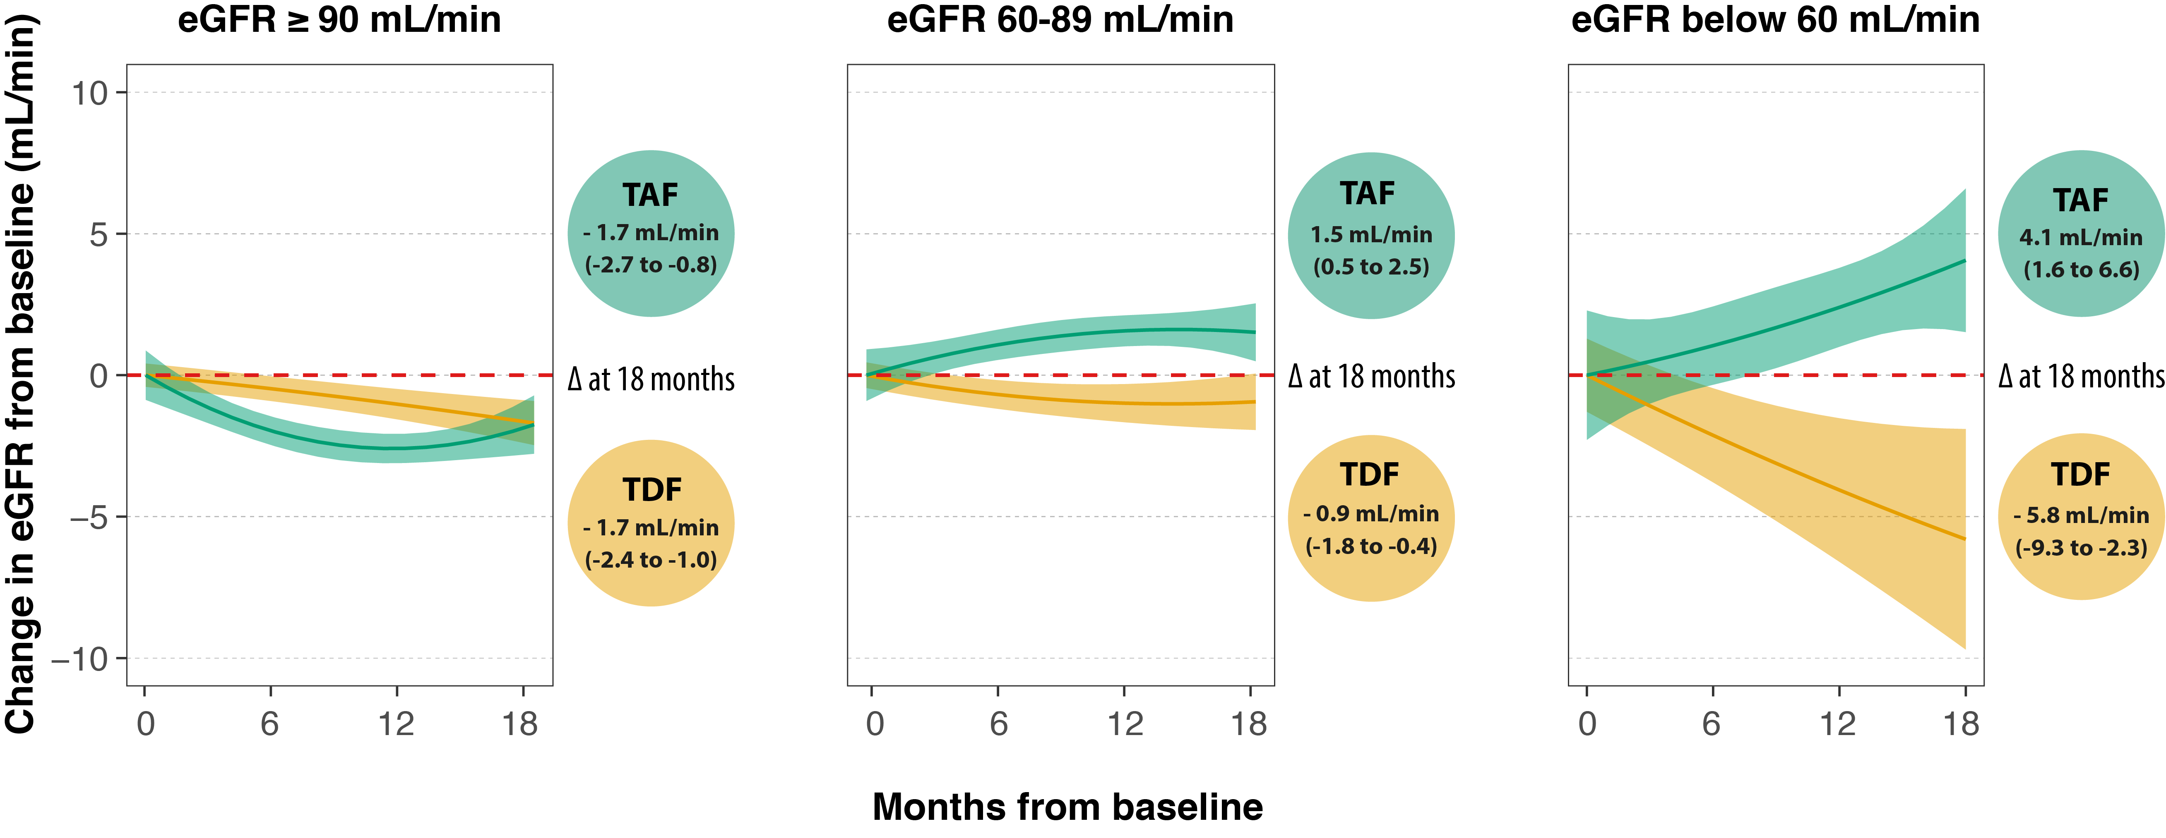
Change in eGFR over time
Adjusted for age, sex, ethnicity, diabetes, arterial hypertension, cardiovascular disease, HCV and HBV infection, use of ritonavir, cobicistat, dolutegravir and cotrimoxazole

Slide 10
Change in eGFR over time
Adjusted for age, sex, ethnicity, diabetes, arterial hypertension, cardiovascular disease, HCV and HBV infection, use of ritonavir, cobicistat, dolutegravir and cotrimoxazole

Slide 11
Change in eGFR over time
Adjusted for age, sex, ethnicity, diabetes, arterial hypertension, cardiovascular disease, HCV and HBV infection, use of ritonavir, cobicistat, dolutegravir and cotrimoxazole

Slide 12
Change in eGFR over time
Adjusted for age, sex, ethnicity, diabetes, arterial hypertension, cardiovascular disease, HCV and HBV infection, use of ritonavir, cobicistat, dolutegravir and cotrimoxazole

Slide 13
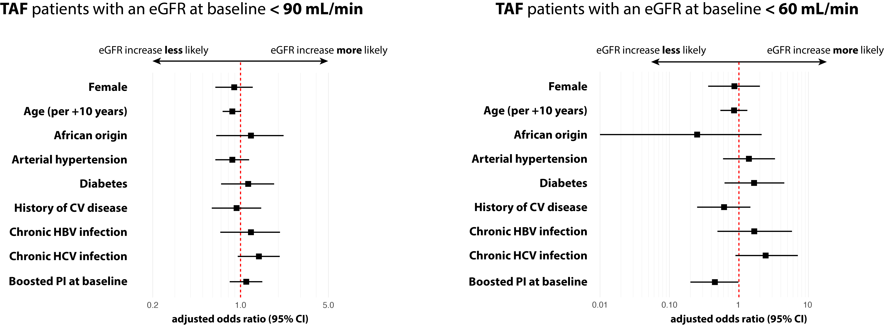
Factors associated with eGFR increase ≥ 10% at 12 months

Slide 14
Factors associated with eGFR increase ≥ 10% at 12 months

Slide 15
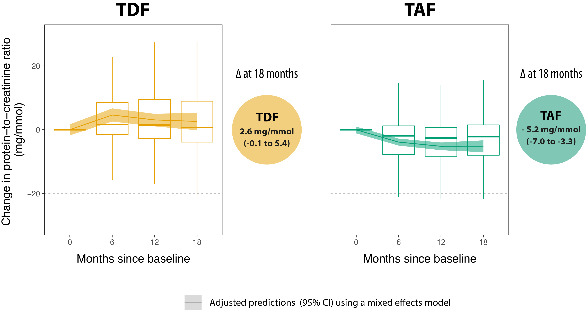
Change in protein-to-creatinine ratio over time

Slide 16
Change in protein-to-creatinine ratio over time

Slide 17
Conclusion
18 months after switch from TDF to TAF, eGFR improved in patients with established renal dysfunction, and remained similar among those with a normal renal function
eGFR improvement may be less likely in the presence of a boosted PI
Protein-to-creatinine ratio decreased after switching from TDF to TAF
Longer term follow-up data are needed to confirm these results

Slide 18
Acknowledgements
Gilles Wandeler
Andri Rauch
Bruno Ledergerber
Alexandra Calmy
Matthias Cavassini
Huldrych Günthard
Helen Kovari
Marcel Stöckle
Enos Bernasconi
Pietro Vernazza
Christoph Fux
Hansjakob Furrer
All participants of the Swiss HIV Cohort Study as well as its members

