Slide 1
Proteomic Evidence of Vesatolimod-induced Enhancement of “Cross-talk” Between Innate and Adaptive Response Cells in HIV Controllers on ART
Yanhui Cai ¹, Steven G. Deeks ², Cynthia Brinson ³, Moti Ramgopal ⁴, Norm Jones ², Edwin DeJesus ⁵, Anthony Mills ⁶, Peter Shalit ⁷, Brian Moldt ¹, Liao Zhang ¹, Gesham Magombedze ¹, Elena Vendrame ¹, Devi SenGupta ¹, Ondrej Podlaha ¹, Jeffrey J. Wallin ¹
¹Gilead Sciences, Foster City, CA, USA; ²University of California San Francisco; ³Central Texas Clinical Research, Austin, TX; ⁴Midway Research Center, Fort Pierce, FL; ⁵Orlando Immunology Center, Orlando, FL; ⁶Men’s Health Foundation, West Hollywood, CA; ⁷Peter Shalit MD and Associates, Seattle, WA
IAS 2021, 18–21 July: Abstract 02171

Slide 2
Study Design for Oral VES in HIV Controllers on ART
Day 1
Week 20
24
48
RNA Rebound ≥200 c/mL
HIV controllers
on ART ≥6 months
N=25
Pre-ART VL 50–5000 c/mL
Placebo
ATI
(24+ wk)
2:1
VES QOW 4–8 mg x 10
  4 mg (n=2)
Participants With
HIV RNA Rebound, %
  4 → 6 mg (n=4)
  6 mg (n=5)
Placebo (n=8)
VES (n=15)
  6 → 8 mg (n=3)
Log-rank p=0.024
  8 mg (n=3)
Week
Viral and immunologic outcomes
  A modest increase in time to viral rebound*, as well as a decrease in viral set point and intact proviral DNA¹
  Induction of dose-dependent interferon response and increased immune-cell activation²
O-link Proteomic Analysis
  Soluble biomarkers significantly elevated following VES dose (Wilcoxon rank-sum test)
  Inferred pathway analysis
ART, antiretroviral therapy; ATI, analytic treatment interruption; c, copies; VES, vesatolimod; VL, viral load.
*Time to virologic rebound = wk from start of ATI to 2 consecutive HIV-1 RNA ≥200 c/mL.
1. SenGupta D, et al. CROI 2020, abstract 3982; 2. Wallin J, et al. AIDS 2020, abstract OAB0205.

Slide 3
VES Activates the Innate Immune Response
CD69⁺ NK
CD16⁺ NK

Slide 4
VES Significantly Increased Markers of Adaptive Immune Response
Ki67⁺ CD4⁺
HLA-DR⁺CD38⁺ CD4⁺
CD38⁺CD8⁺
CD69⁺CD8⁺

Slide 5
Soluble Proteins Increased Significantly 1 Day After VES Administration
 |  | 1 Day After Dose 1 |  | 1 Day After Dose 10
 |  | p Value | Significant Symbol | p Value | Significant symbol
CD27 Molecule | (CD27) | 0.006 | ** | 0.013 | *
CD8 Alpha Chain | (CD8A) | <0.001 | *** | <0.001 | ***
Cytotoxic and Regulatory T Cell Molecule | (CRTAM) | 0.004 | ** | 0.016 | *
Macrophage Colony-Stimulating Factor 1 | (CSF-1) | 0.002 | ** | <0.001 | ***
Fractalkine | (CX3CL1) | 0.003 | ** | 0.016 | *
C-X-C Motif Chemokine 10 | (CXCL10) | 0.000 | *** | <0.001 | ***
C-X-C Motif Chemokine 11 | (CXCL11) | 0.001 | ** | 0.011 | *
C-X-C Motif Chemokine 13 | (CXCL13) | 0.009 | ** | 0.013 | *
C-X-C Motif Chemokine 9 | (CXCL9) | 0.005 | ** | <0.001 | ***
Fas Ligand | (FASLG) | 0.007 | ** | <0.001 | ***
Galectin 9 | (Gal-9) | 0.006 | ** | 0.007 | **
Interferon Gamma | (IFN-γ) | 0.009 | ** | 0.040 | *
Interleukin 10 | (IL-10) | 0.002 | ** | 0.019 | *
Interleukin 12 | (IL-12) | <0.001 | *** | <0.001 | ***
Interleukin 12 Receptor Subunit Beta 1 | (IL-12RB1) | 0.003 | ** | <0.001 | ***
Interleukin 15 | (IL-15) | 0.002 | ** | 0.019 | *
Lysosome Associated Membrane Glycoprot 3 | (LAMP3) | 0.003 | ** | 0.008 | **
C-C Motif Chemokine 8 | (MCP-2) | 0.003 | ** | 0.013 | *
Programmed Cell Death 1 Ligand 1 | (PD-L1) | 0.004 | ** | 0.007 | **
Programmed Cell Death 1 Ligand 2 | (PD-L2) | 0.009 | ** | 0.023 | *
Pleiotrophin | (PTN) | 0.019 | * | 0.034 | *
Tumor Necrosis Factor | (TNF) | <0.001 | *** | <0.001 | ***
Tumor Necrosis Factor Ligand S family 10 | (TRAIL) | <0.001 | *** | 0.001 | **

Slide 6
Changes in Inferred Pathways and Immune Responses Associated with VES Treatment
Inferred Immune Responses
Inferred Pathways Changes Following VES Treatment
Coverage %
19.10
13.10
14.30
6.81
31.70
6.49
14.50
3.66
5.09
6.56
3.39
2.61
12.80
Z-score
Plasma proteomic changes revealed:
A significant enrichment of pathways associated with immune responses following VES treatment, which included pathways involved in T cell differentiation, recruitment, and migration
VES treatment resulted in enrichment in pathways involved in the crosstalk between dendritic cells and NK cells, NK cell signaling, Th1 pathway, and antiviral responses
Z-score
Only those with Z ≥1.96 or ≤-1.96 are shown.

Slide 7
Inferred Functional Changes Associated with Delayed Viral Rebound in VES-treated HIV Controllers
Coverage %
3.39
4.63
6.19
9.71
Z-score
Only those with Z ≥1.96 or ≤-1.96 are shown.
Biomarkers and pathways associated with inflammation were lower in VES-treated participants with delayed viral rebound (defined as plasma viral load <50 c/mL for ≥6 weeks, n=4) compared to VES-treated participants who rebounded sooner than 6 weeks
Participants with delayed rebound showed enrichment in pathways associated with lymphocyte responses and decrease in pathways associated with impaired effector function

Slide 8
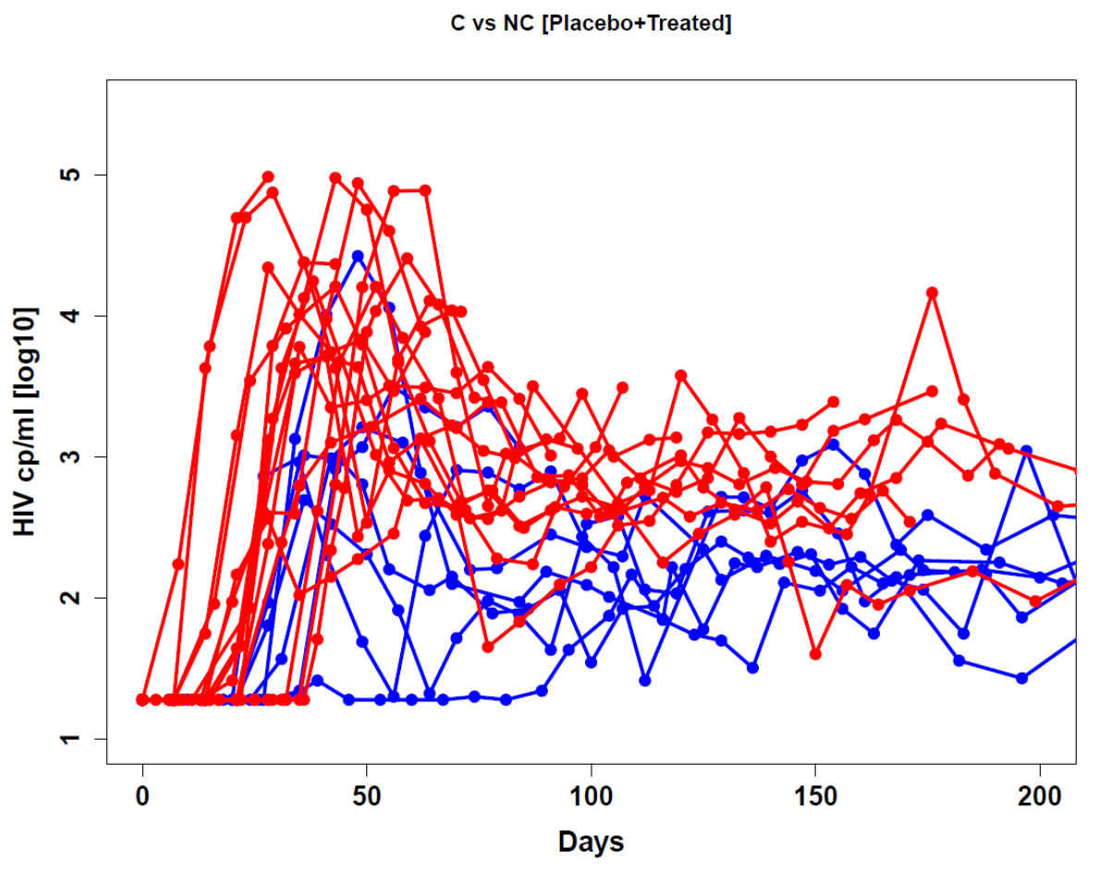
HIV Controllers According to Viral Data Modeling Outcomes
Ranking of Predictors
Day 1
Week 20
24
48
0.5
0.4
PLWH controllers
on ART ≥6 months (N=25)
Pre-ART VL 50–5000 c/mL
Placebo (n=8)
ATI
(24+ wk)
0.3
2:1
% Importance
VES QOW 4–8 mg x 10 (n=17)
0.2
0.1
0.0
1
2
3
4
Peak
Slope-1
Time
to Peak
Time to
Rebound
Viral Load Dynamic during ATI
Non-controller
Controller: Off ART plasma HIV-1 RNA ≤400 c/mL for ≥ 2/3 of time points for ≥24 weeks
Controller
25%
65%
75%
35%
Placebo (n=8)
Ves-treated (n=17)

Slide 9
Inferred Pathway Changes Associated with HIV Viral Controllers
Coverage %
1.36
3.33
3.42
5.19
8.00
1.35
6.67
3.26
2.84
6.49
5.88
50.00
4.55
5.08
6.38
8.11
13.90
43.50
4.40
5.47
4.17
18.70
3.08
5.90
3.64
6.77
13.20
12.90
18.80
15.10
8.99
Only those with Z ≥ 1.96 or ≤ -1.96 are shown.

Slide 10
Conclusions
High-throughput proteomic analysis approach allowed for exploration of mechanisms associated with VES treatment outcomes
VES cumulatively induced innate and adaptive immune cell activation in HIV controllers
  NK effector function may also be increased
Extensive shifts in immune function after VES administration
  Evidence of “cross-talk” between innate and adaptive immune responses
  Lower inflammatory response in those participants with delayed HIV rebound (≥6 weeks) or viral controllers*
These findings support the hypothesis that achievement of post-ART HIV control requires a combination of increased cellular immune responses coupled with a balanced inflammatory response
*Off ART plasma HIV-1 RNA ≤400 copies/mL for ≥ 2/3 of time points for ≥24 weeks.

Slide 11
Acknowledgments
We extend our thanks to the participants, their partners and families.
Special thanks to the study teams.
Principal Investigator: Steven Deeks
Clinical Investigators: Moti Ramgopal, Cynthia Brinson, Edwin DeJesus, Anthony Mills,
Peter Shalit
Biomarker/Microbiome Analysis:
UCSF Core Immunology Lab: Norman Jones, Valerie Girling
Accelevir Diagnostics: Gregory Laird
Gilead: Ondrej Podlaha, Jeff Wallin, Liao Zhang, Peter Shweh, Brian Moldt, Gesham Magombedze, Romas Geleziunas, Elena Vendrame, and Devi SenGupta
These studies were funded by Gilead Sciences, Inc.

