Slide 1
Real-world utilization of F/TDF and F/TAF for HIV Pre-exposure Prophylaxis during the COVID-19 pandemic in the US December 2019 – December 2020
Li Tao, Christoph Carter, Moupali Das, Valentina Shvachko, and David Magnuson
Gilead Sciences Inc., Foster City, CA USA
IAS 2021
July 18-22, 2021

Slide 2
Disclosures
All authors are employees and shareholders of Gilead Sciences, Inc.

Slide 3
Introduction and Study Objective
F/TDF (emtricitabine/tenofovir disoproxil fumarate) and F/TAF (emtricitabine tenofovir alafenamide) are highly effective for HIV prevention (pre-exposure prophylaxis; PrEP)
FDA approved F/TDF for PrEP for adults at risk for HIV infection in 2012, and for adolescents in 2018; F/TAF was approved in 2019 for adults and adolescent males
Up to 99% effective when taken daily
Generic brand F/TDF launched in the US in October 2020
The Coronavirus Disease 2019 (COVID-19) pandemic has fundamentally changed healthcare and aspects of life in the US since January 2020. As the pandemic and measures taken to control it led to changes in sexual risk behavior and disruption in HIV prevention services including the use of daily F/TDF and F/TAF for HIV PrEP, however, the overall potential impact on trend of PrEP utilization in the real-world is not known
This analysis aims to describe the real-world pattern of F/TDF and F/TAF for HIV PrEP use from December 01, 2019 to December 31, 2020

Slide 4
Methods – PrEP User Cohort
Real-world data obtained from a de-identified national, electronic pharmacy claims database collected from at least 80% of all US retail pharmacies
Information on prescription refill, medical claims and procedures, and individual demographics
A validated algorithm identified PrEP users of (F/TDF [branded and generic] and F/TAF) for HIV PrEP by excluding use for HIV treatment, post-exposure prophylaxis (PEP), and off-label chronic hepatitis B treatment¹
Statistical analysis: retrospective descriptive trend analysis
1 – R Mera-Giler, et al. National HIV Prevention Conference, Dec 2015, Atlanta, GA
Notes:
CORE_Efficacy_Safety_Feb-14_SLB.ppt
6/29/2021
Gilead
4

Slide 5
Results – PrEP user cohort
A total of 123,983 individuals initiated PrEP (incident users) between 12/01/2019 and 12/31/2020 in the US
Median age at PrEP initiation was 33 years (IQR 27 - 44)
Median age at F/TDF initiation was 31 years (IQR 25 – 40)
Median total time on F/TDF was 90 days (IQR 30 – 167)
Median age at F/TAF initiation was 35 years (IQR 28 – 46)
Median total time on F/TAF was 150 days (IQR 78 – 274)
In December 2020, there were 130,102 users on PrEP (prevalent users)
58% of the users were between the age of 26 and 44
94% were males
No information on transgender status
42,586 individuals initiated generic F/TDF between 10/01/2020 and 12/31/2020
 | Incident Users Dec 2019-Dec 2020 | Prevalent Users in Dec 2020
All | 123,983 | 130,102
Age at PrEP Initiation
12-17 | 592 (1%) | 228 (0%)
18-25 | 24,331 (20%) | 16,892 (13%)
26-44 | 69,783 (56%) | 76,065 (58%)
45+ | 29,277 (24%) | 36,917 (28%)
Sex
Male | 111,420 (90%) | 122,826 (94%)
Female | 12,563 (10%) | 7,276 (6%)
Race/ethnicity
White | 31,284 (25%) | 39,430 (30%)
African American | 7,436 (6%) | 7,257 (6%)
Hispanic | 8,225 (7%) | 8,722 (7%)
Asian/Other | 1,825 (2%) | 2,239 (2%)

Slide 6
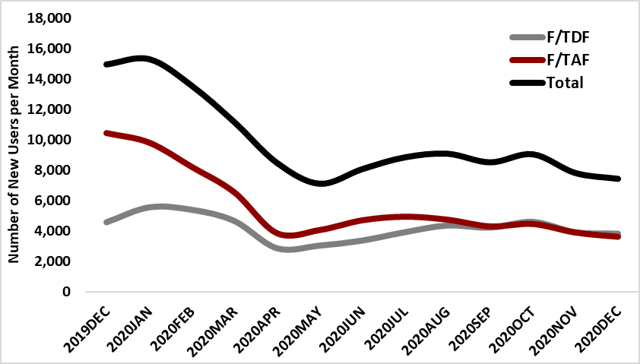
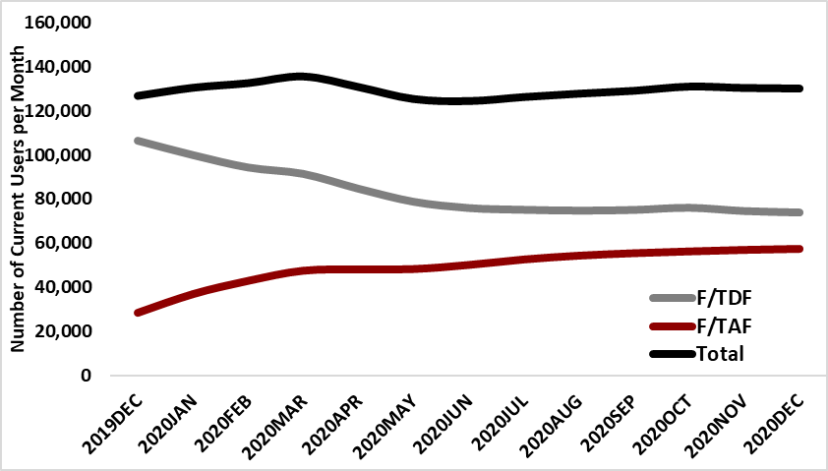
Results – Number of F/TAF and F/TDF for PrEP users, Dec 2019 - Dec 2020
Individuals on PrEP for the first time (Incident Users)
Current PrEP users (Prevalent Users)
Progressive drops in PrEP initiation in February - April 2020 in the US
PrEP initiation started to increase after April, with more PrEP prescriptions coming from family physicians and nurse practitioners/physician assistants, and prescriptions from mail-in orders
The overall number of users on PrEP (prevalent users) showed only a slight decrease in April and May and increased after June 2020

Slide 7
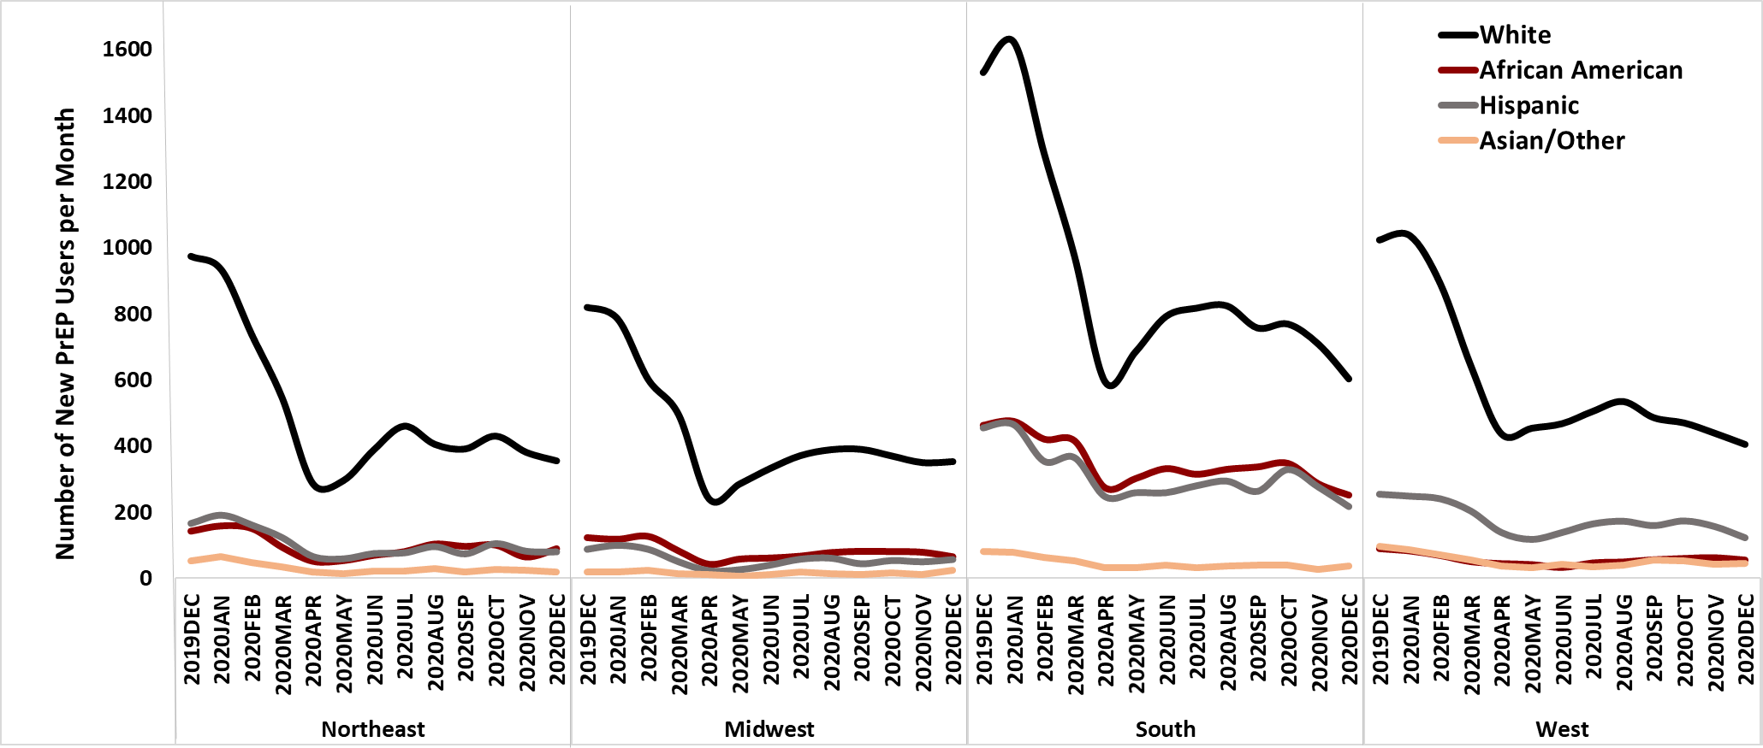
Results – Number of F/TAF and F/TDF for PrEP users by region and race/ethnicity, Dec 2019 - Dec 2020
Decreases in new PrEP use were seen in multiple geographic areas and across race/ethnicity groups in the US, with decreases most pronounced in white individuals living in the Southern US states

Slide 8
Limitations and Conclusions
Limitations due to the use of claims data:
Only indicates when a prescription was filled and not that the person took the medication
No dosing information (e.g., daily dosing or on-demand dosing)
Only insured users and healthcare activities during specific enrollment periods were studied
About 50% missing on race/ethnicity; no data on risk factors for HIV or gender
The COVID-19 pandemic has led to unprecedented behavioral changes and healthcare delivery transformations, including a substantial impact on PrEP initiations after February 2020, while having a lesser impact on overall use from December 2019 to December 2020 in the US
These findings demonstrate how real-world data such as pharmacy claims data can be used to track PrEP use amidst the significant impact of the COVID-19 pandemic
Targeted efforts will be needed to provide PrEP to new users during and after the pandemic
Notes:
CORE_Efficacy_Safety_Feb-14_SLB.ppt
6/29/2021
Gilead
8

